Slide 1
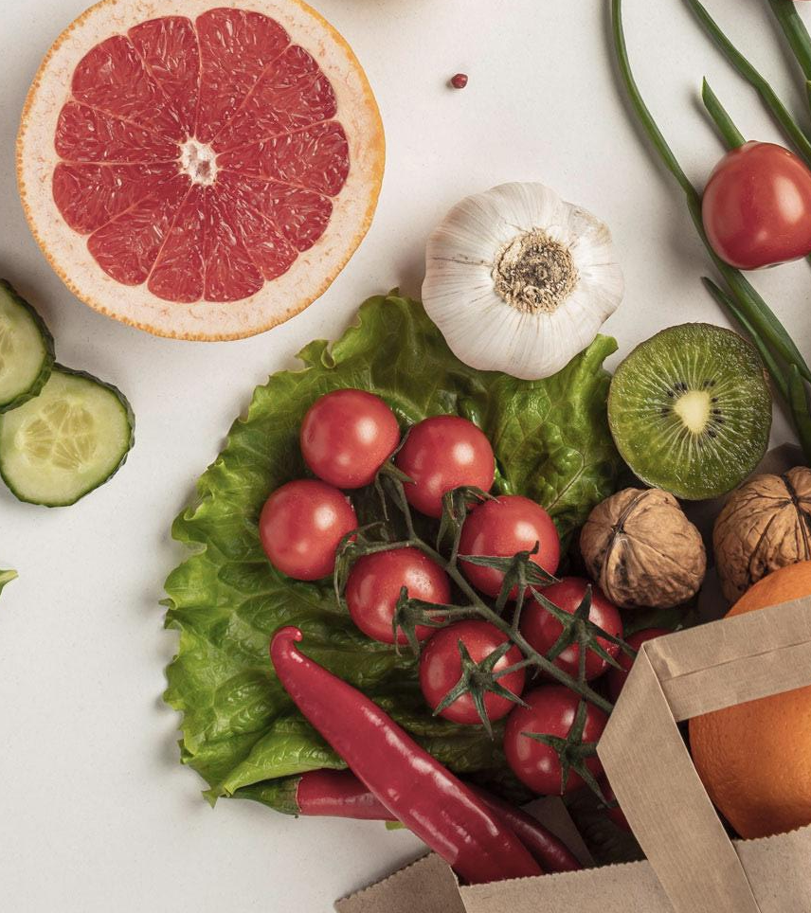
Nutrition
Healthy Glow, Healthy Life!

Slide 2




Slide 3
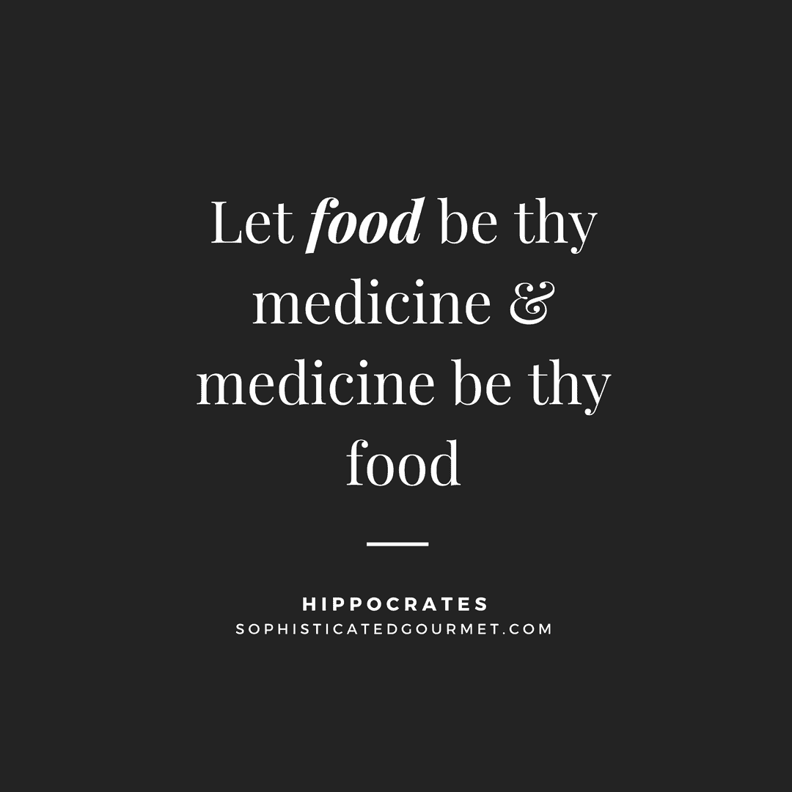


Slide 4
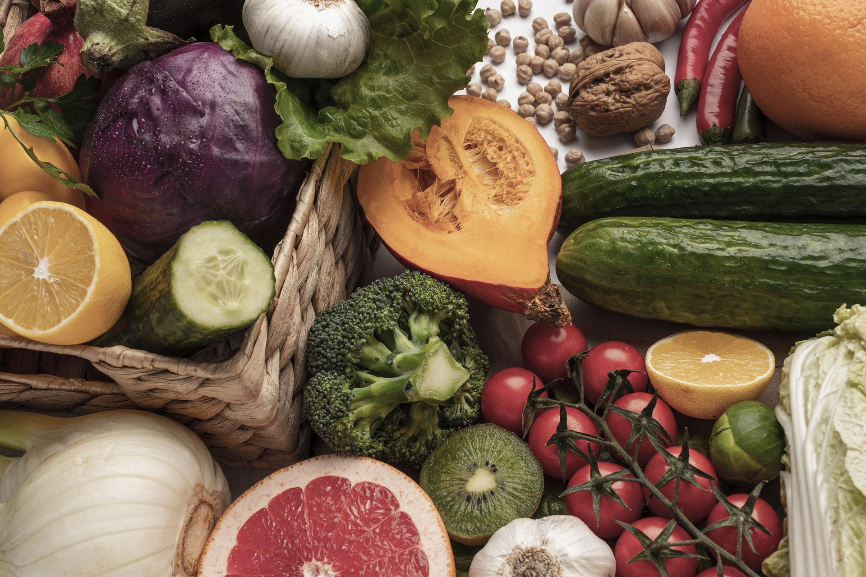
What Comes To Your Mind When You Think Of Food?
https://www.mentimeter.com/s/46a0c8abce7f4441df02c90ae328998f/048d9247e887/edit?new

Slide 5
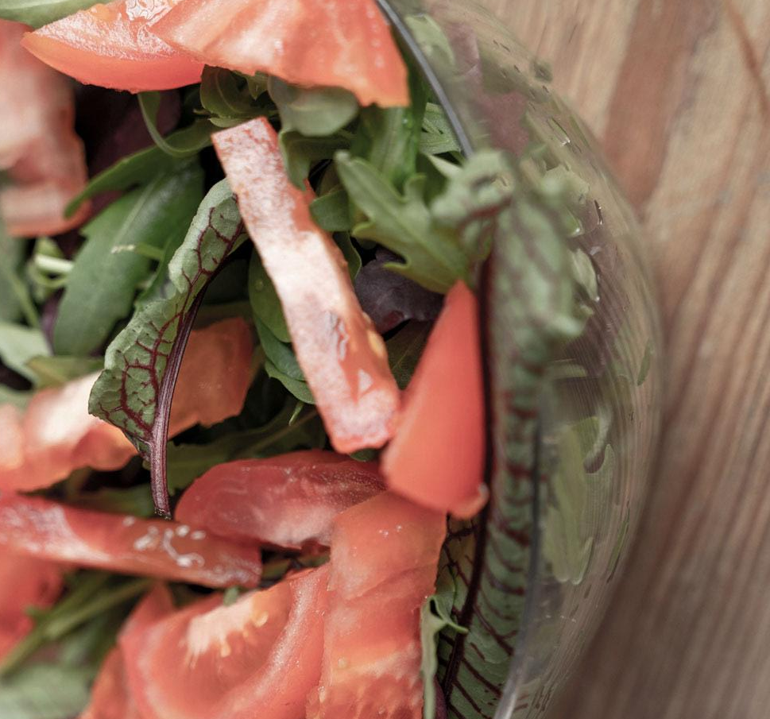
Myth or Fact?
Eating too much Carbohydrate will make you fat.
Proteins can only be found in animal products.
All Fats are Bad.
One can eat as much fruit and vegetables, regardless.
Water is a Nutrient.

Slide 6
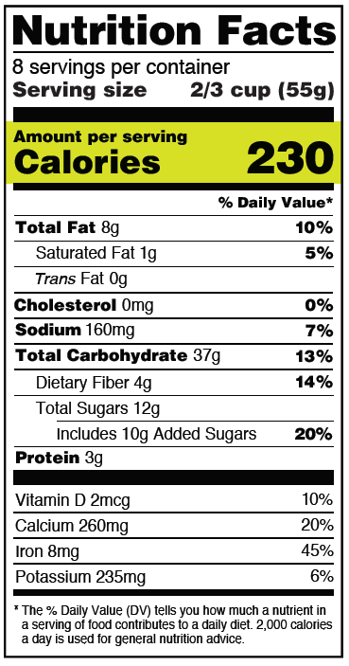
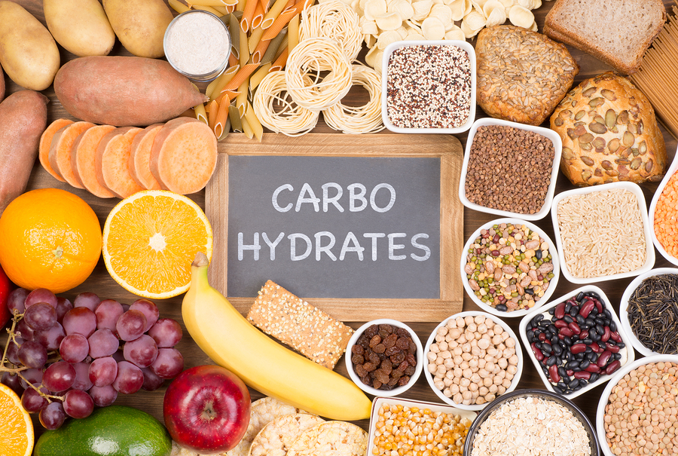
Carbohydrates
Known as “Carbs”
Provides as the MAIN source of ENERGY.
60% of our body requirement is needed, equivalent to 6-8 servings per day.
Is expressed in “Calories”

Slide 7
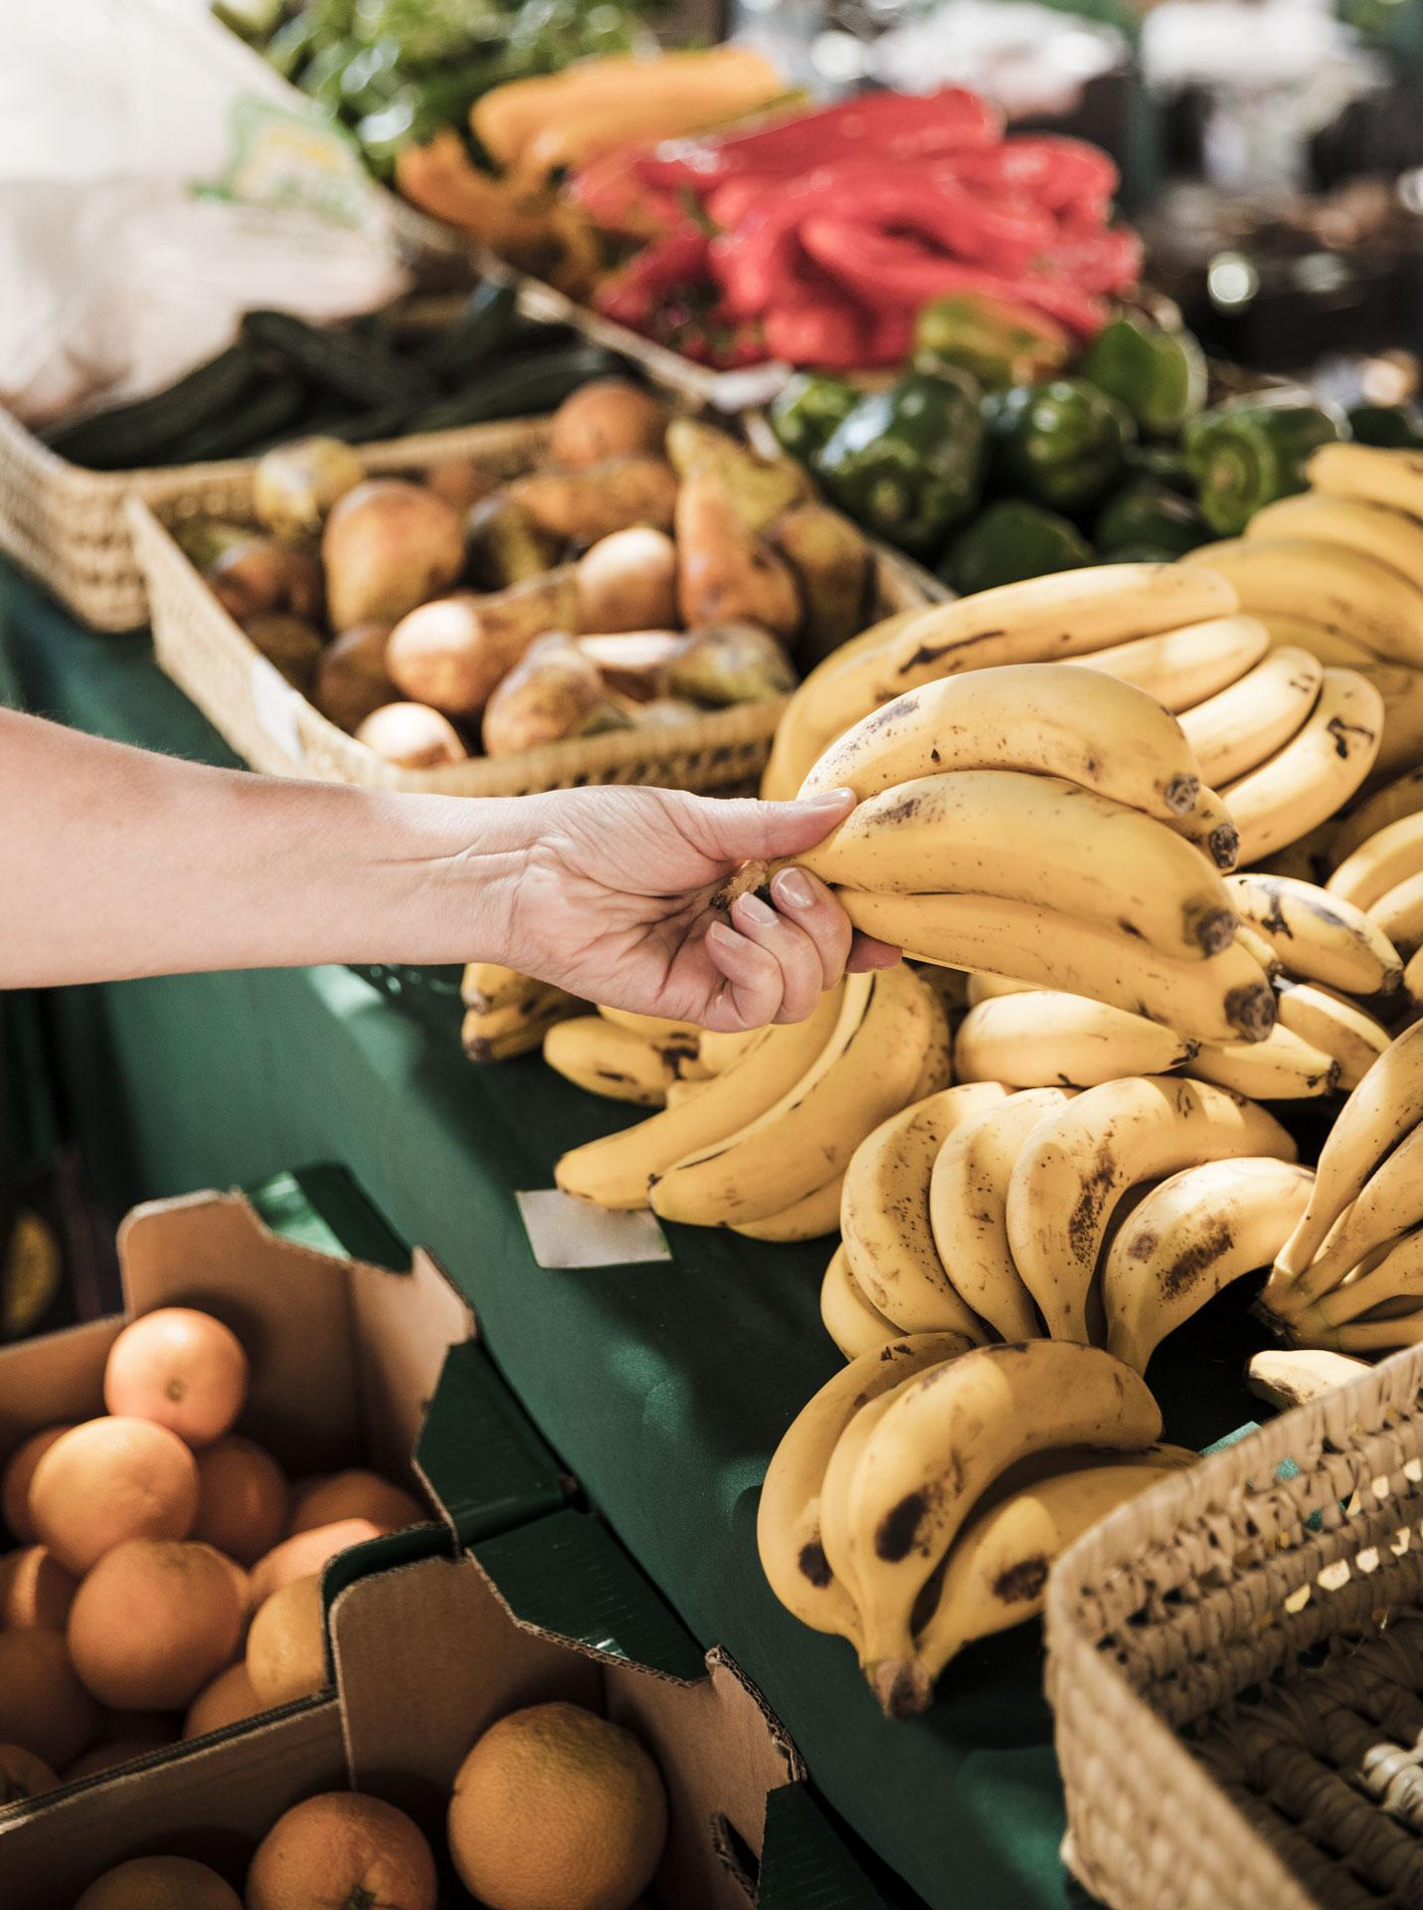
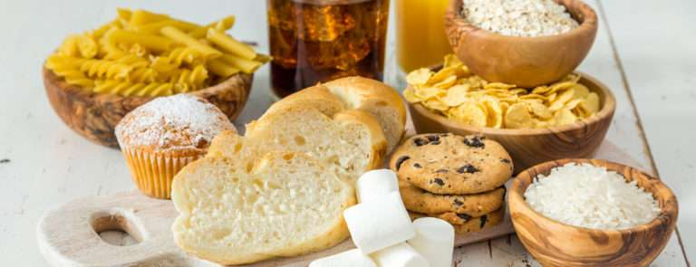
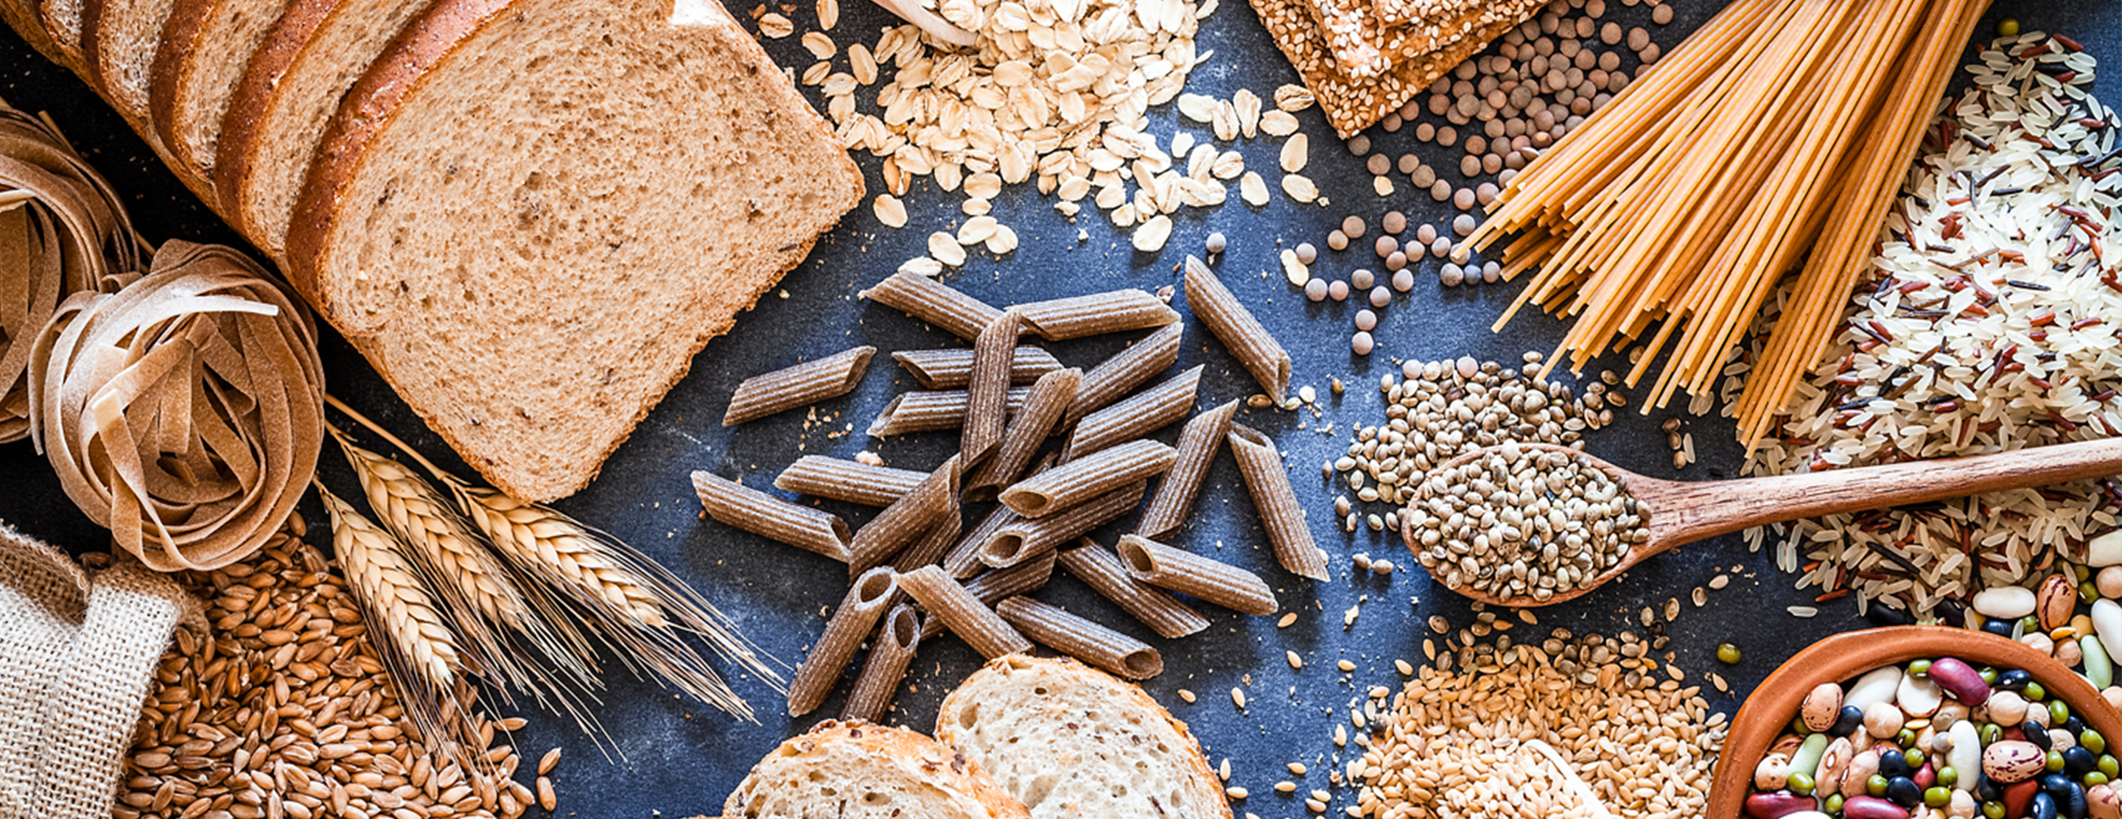
Two Classifications
01
02
Simple
Complex
Are PROCESSED grains.
Easily broken down.
Provides a “quick fix” when hungry.
Increases blood sugar easily.
Labelled as the “bad carbs”
WHOLE grains.
Blood sugar is burned down slowly.
Provides a longer stream of enery througout the day.

Slide 8
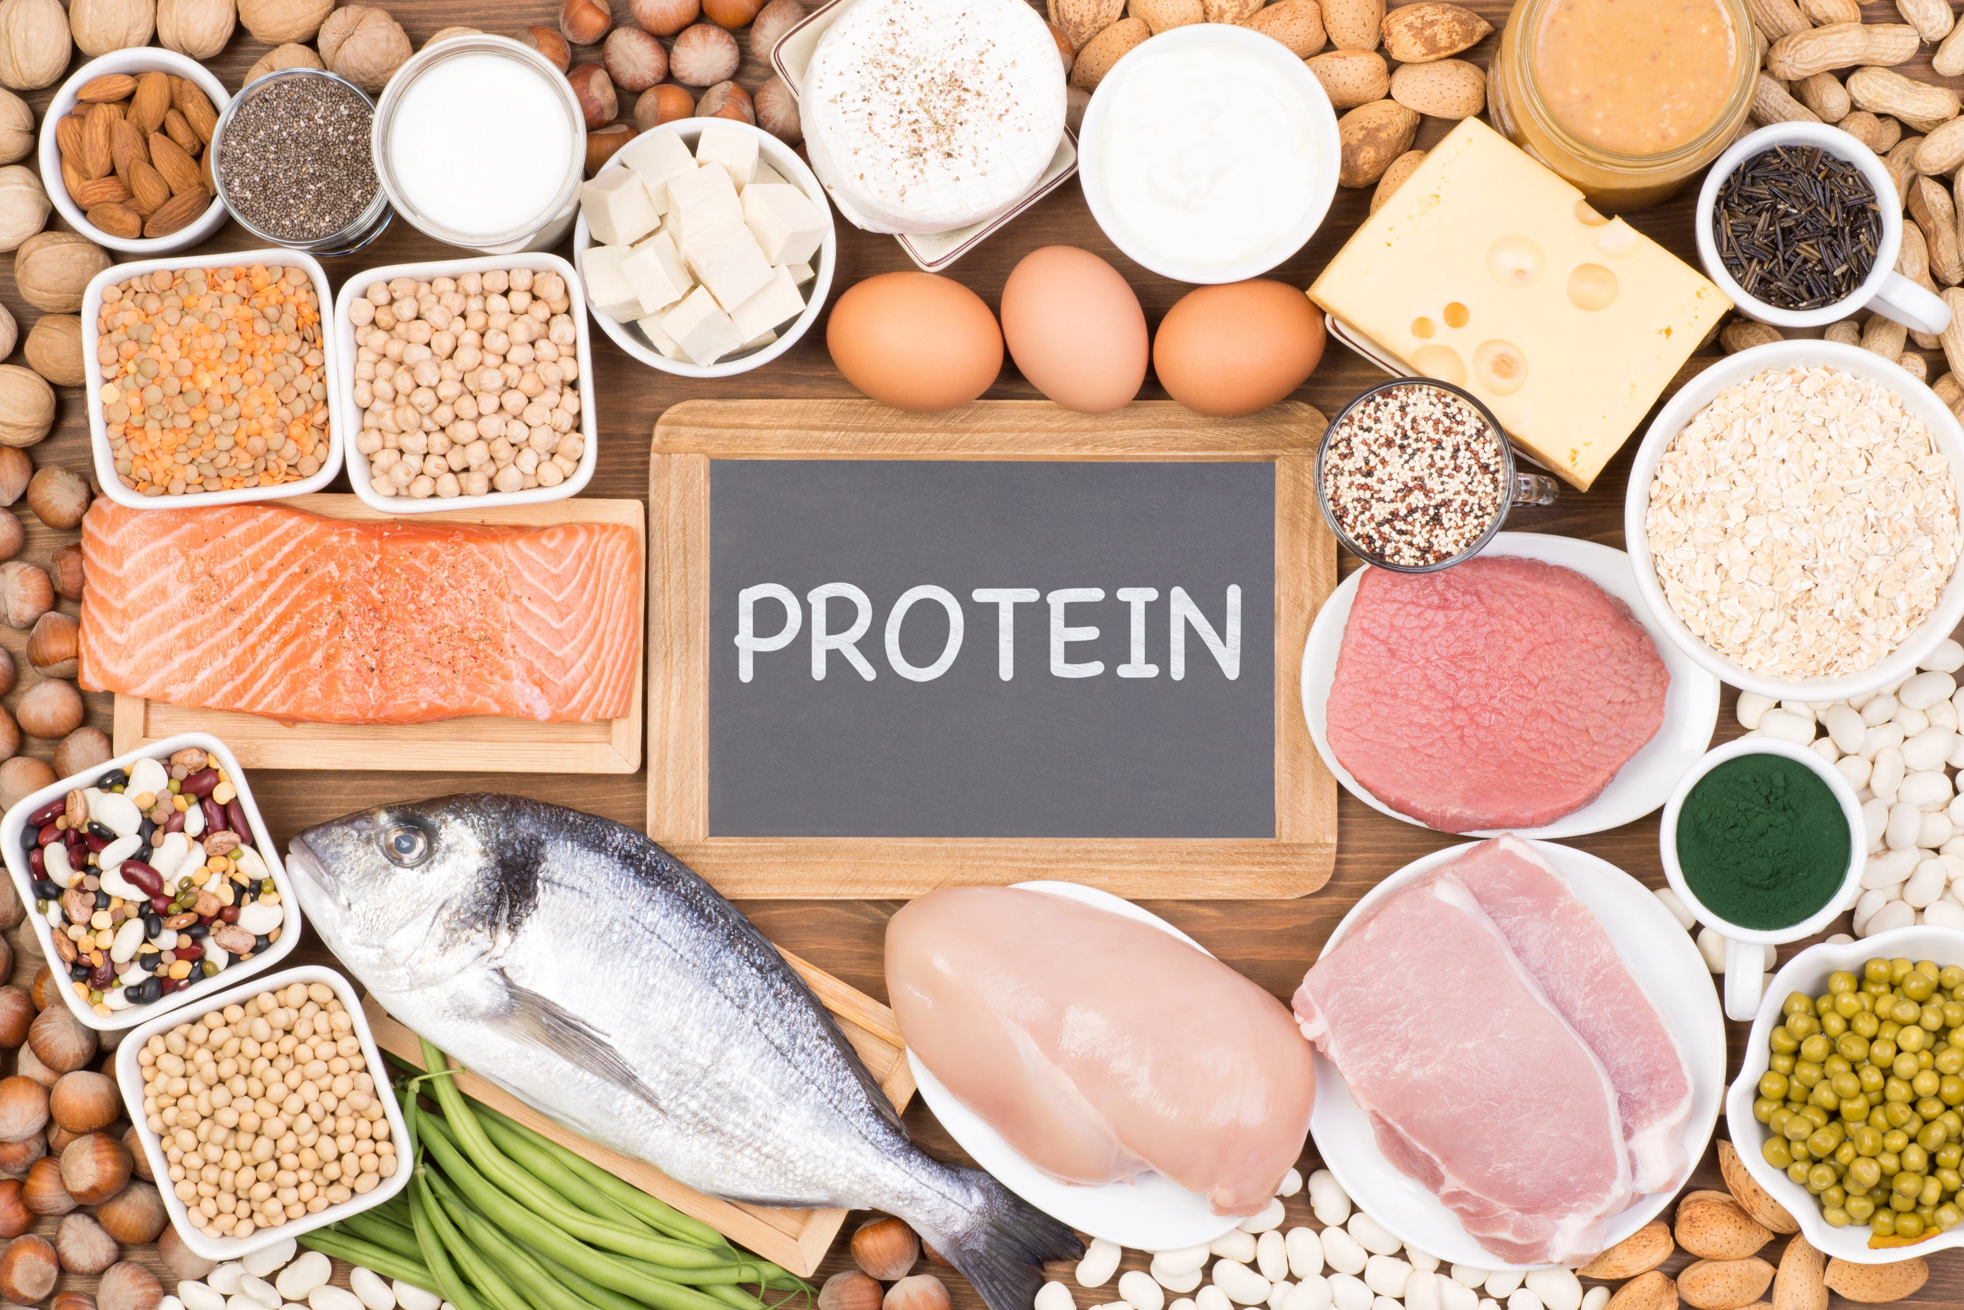
Proteins
A very ESSENTIAL nutrient composed of 22 small chain links called “amino acids”
Amino acids are building blocks that protects and regulates the structures of body tissues and organs.
At least 15-20% of our body requirement is from protein (+-85gm/day) or two servings/day.

Slide 9
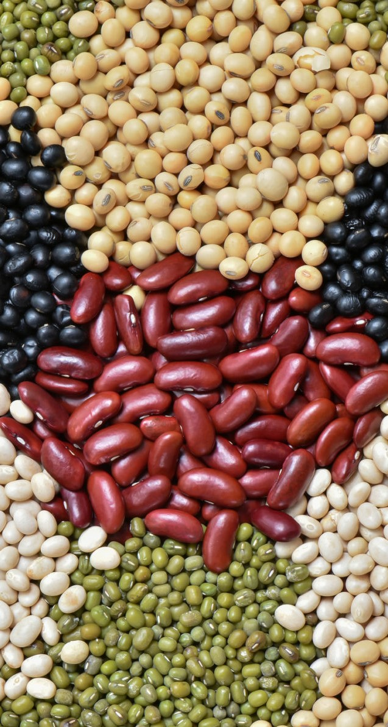
Two Sources of Protein
01
02
Plant-Based Proteints
Animal-Based Proteins
Are the BEST Choice for protein.
Contains very few fats and calories.
Is able to give you the right amount you need for the day.
Examples: ALL KINDS OF BEANS and LEGUMES
Very common.
Contains saturated fats and cholesterol.
Poultry, fish and eggs would be the best choice.
Minimal consumption of Red meats (beef, pork, lamb, mutton).
Processed meats (bacon, ham, hot dogs, sausages, pepperoni, pastrami, etc) must be avoided.

Slide 10
Fats
A nutrient that is important in certain functions: energy-giving, act as buffer, absorption of certain vitamins (A,D,E and K)
At least 20-35 of total calories consumed are from fat

Slide 11


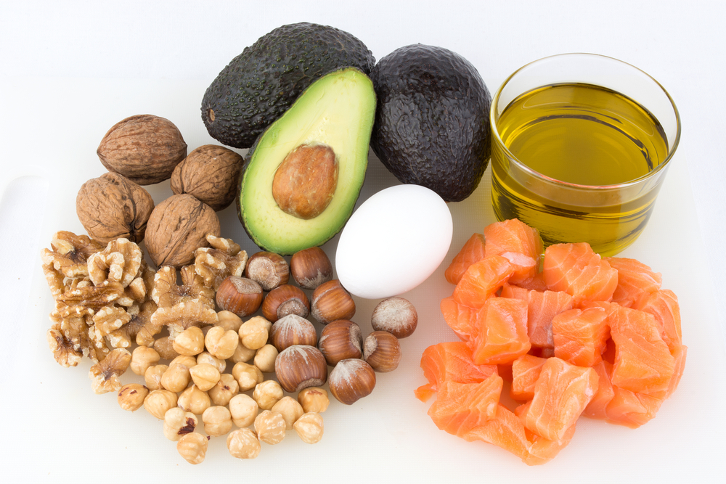
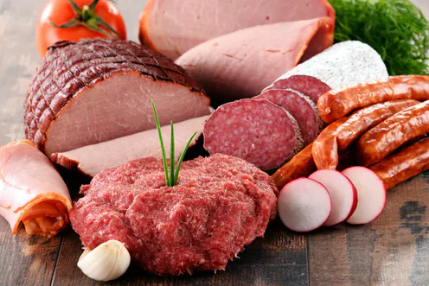
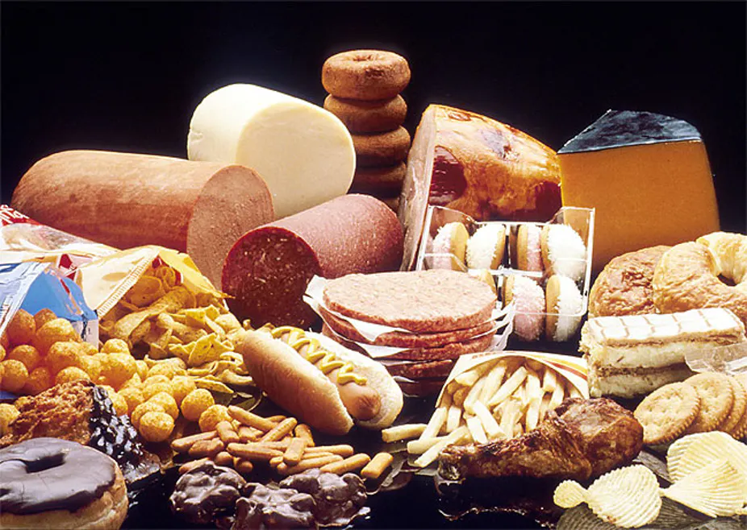
The Good, The Bad and the Ugly FATS
Unsaturated Fats
Saturated Fats
Trans Fats

Slide 12
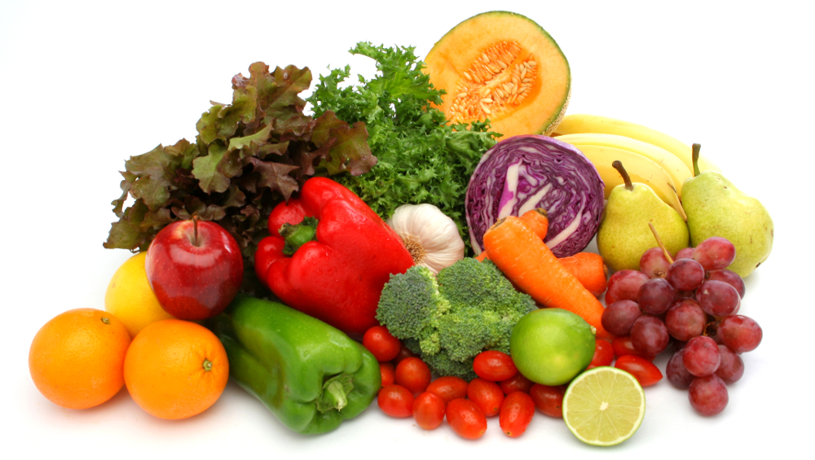
Vitamins and Minerals
Are protective foods
Protect the body against infections, deficiency and diseases.
Found in vegetables, fruits and wholegrains.
Minimum of five servings per day.

Slide 13

Water
Water is a vital nutrient.
It regulates body temperature.
It protects your tissues, spinal cord, and joints.
It helps excrete waste.
Aids in digestion. Helps one lose weight.
It boosts mental capacity. It improves mood.
Being attentive to the amount of water you drink each day is important for optimal health. THIRST should not be an indication to drink water but THIRST is a sign that you are DEHYDRATED. Drink before you are thirsty!

Slide 14

Tips about Drinking Water.
Carry a water bottle with you wherever you go. This way you can drink whenever the need strikes.
Keep track of your intake. Aim to take in optimum amounts every day, at least 1.5-2.5L.
Pace yourself to approach half of your recommended consumption by midday. You can always finish about an hour before you plan to sleep.
Train yourself to drink 30 minutes before or after your meal. Avoid interrupting your meal with water, it disrupts digestion.

Slide 15

Let’s Review
Complex carbohydrates are the BEST choice. As much as possible, avoid too much refined carbohydrates (roti canai, white bread, white rice, pasta, noodles)
Plant-based proteins (tofu, beans, legumes) are the BEST choice. If one wants to consume animal product, do it in this hierarchy: fish, poultry, eggs and dairy. Avoid red meats.
Trans Fats (from any deep fried foods, processed foods, baked goods, frozen pizza, non dairy coffee creamer) must be avoided and consumed in SMALLEST amount.
Consume as MUCH vegetables and fruits!
Drink water. Avoid sweetened, sugary drinks.

Slide 16
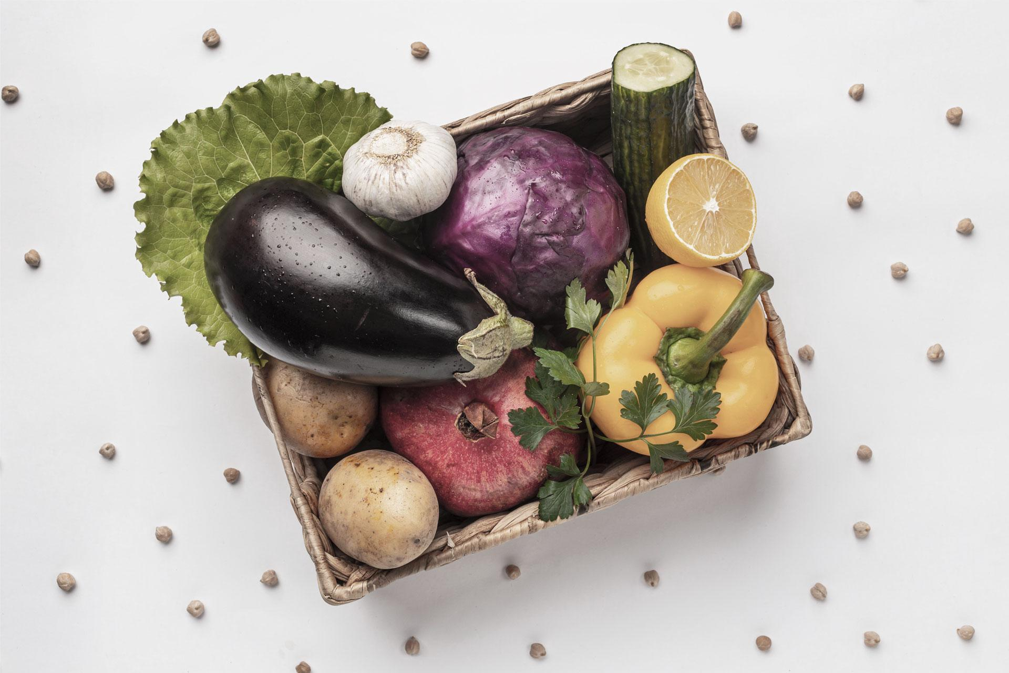
How Much To Eat?
02
Serving Sizes

Slide 17
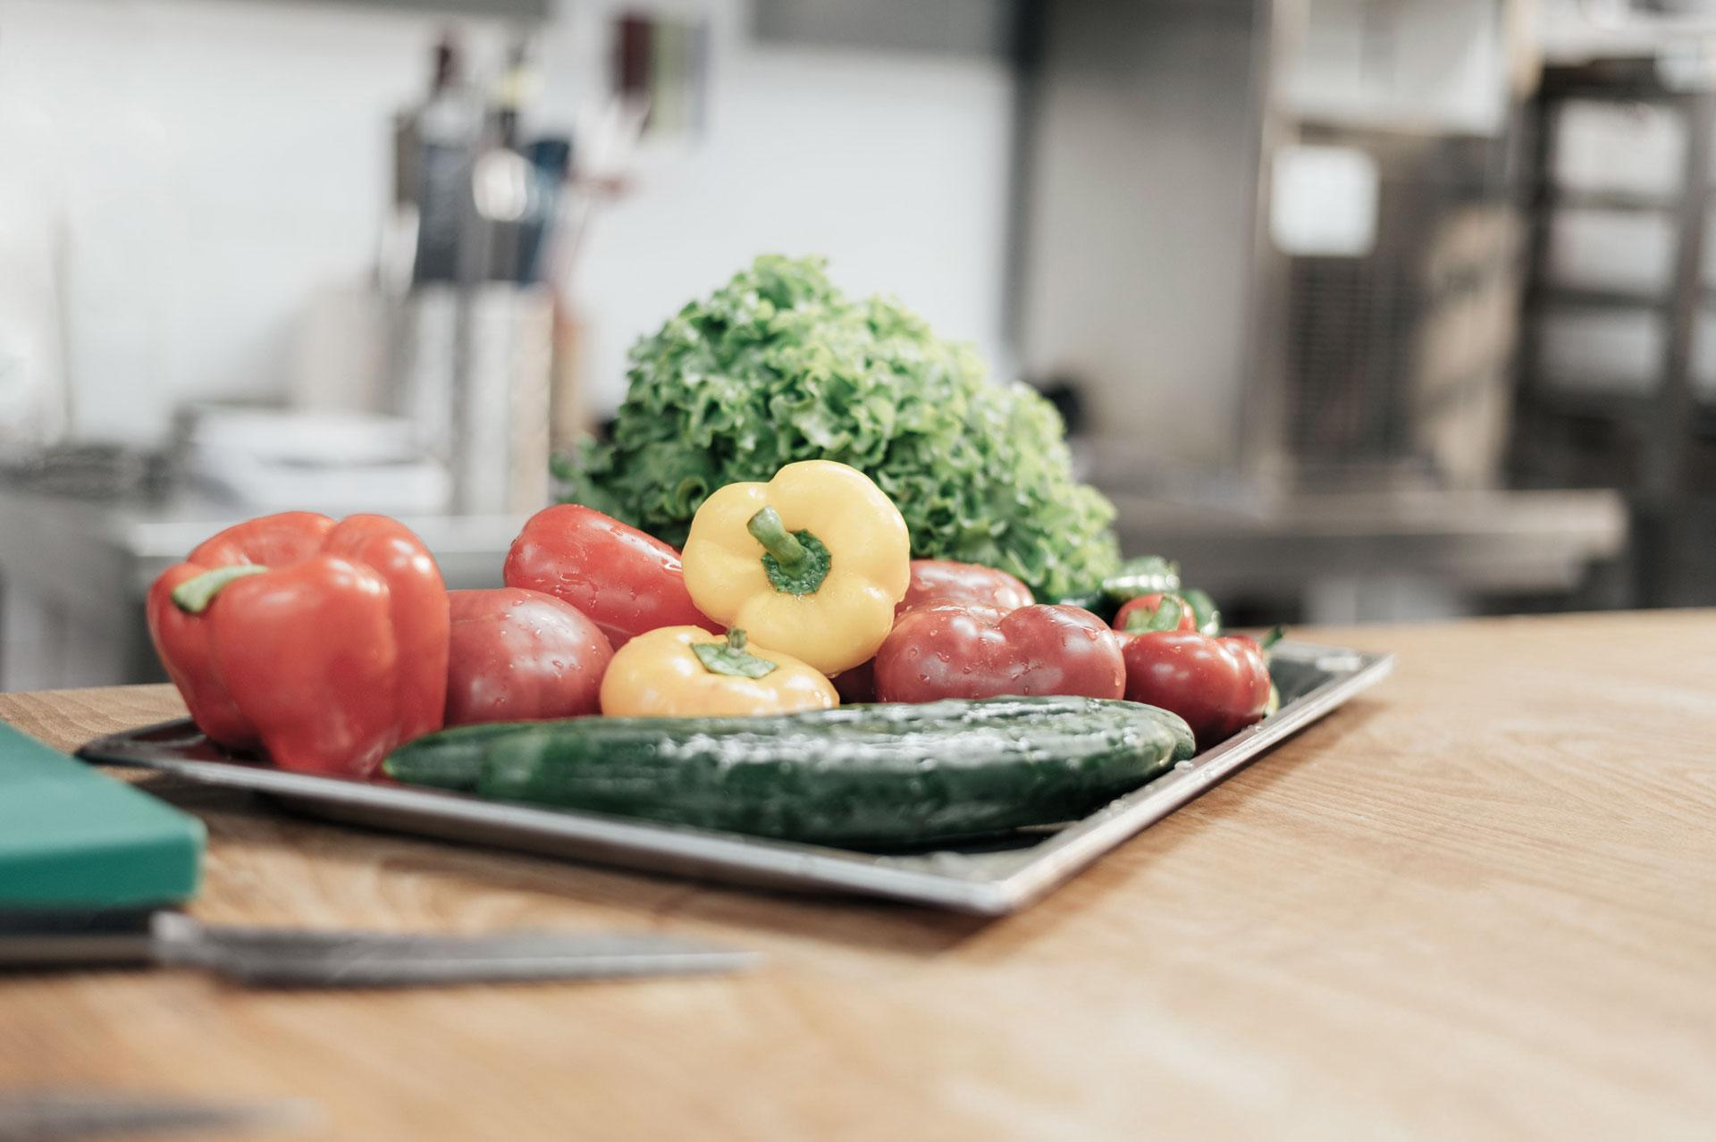
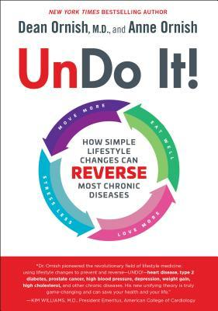
—Dr. Dean Ornish
“Someone once asked Swami Satchidananda, a spiritual teacher, “What are you, a Hindu?” “No,” he replied, “I’m an Undo. I’m trying to teach people how they can undo the patterns that cause damage to their minds and bodies so they can begin to heal.”

Slide 18
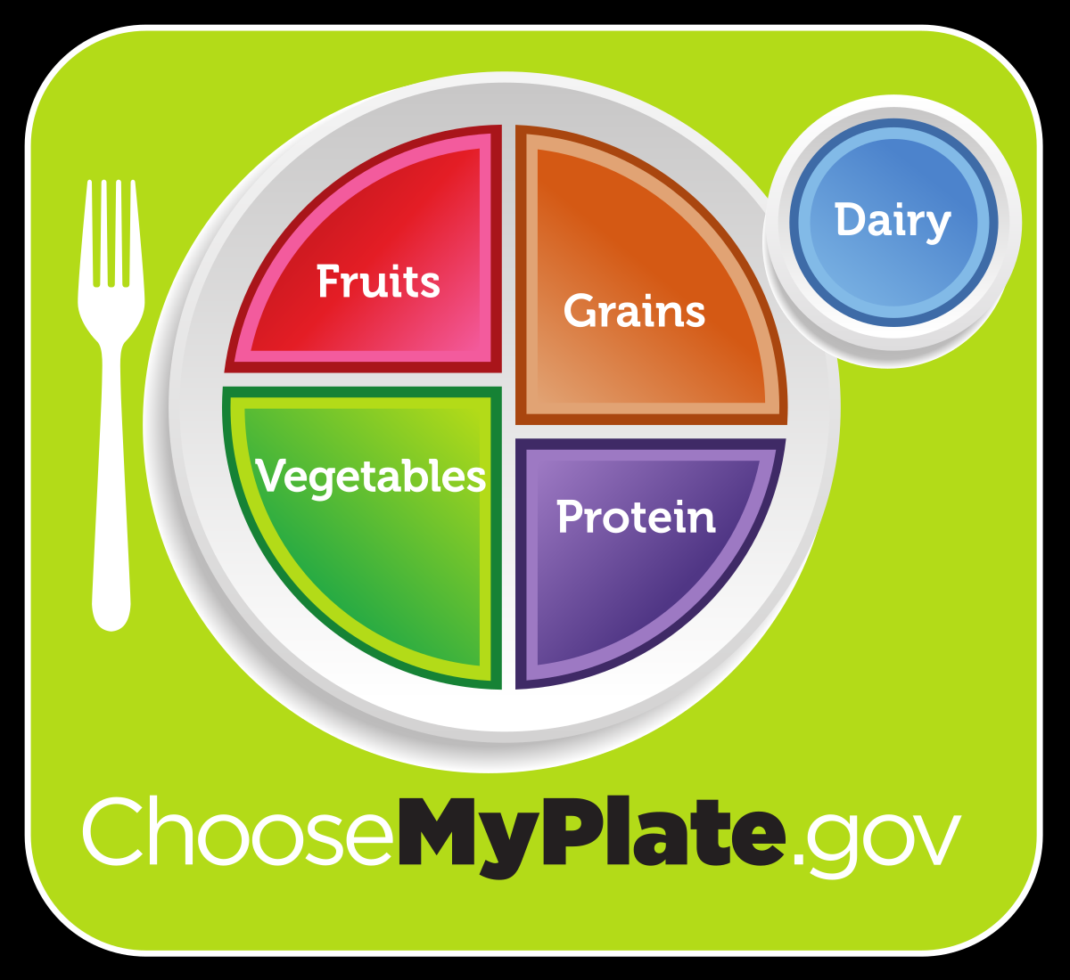
My Plate
MyPlate is the current nutrition guide published by the USDA’s Center for Nutrition Policy and Promotion.
It replaced the previous “Food Pyramid” guide which run for almost 19 years!
It is divided into four sections of approximately 30 percent grains, 40 percent vegetables, 0 percent fruit and 20 percent protein, accompanied by a smaller circle representing dairy, such as a glass of milk or a yogurt cup.

Slide 19
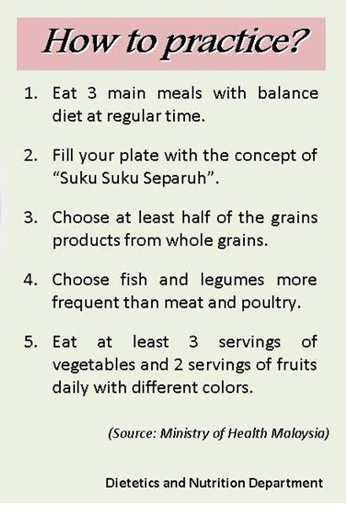


Slide 20
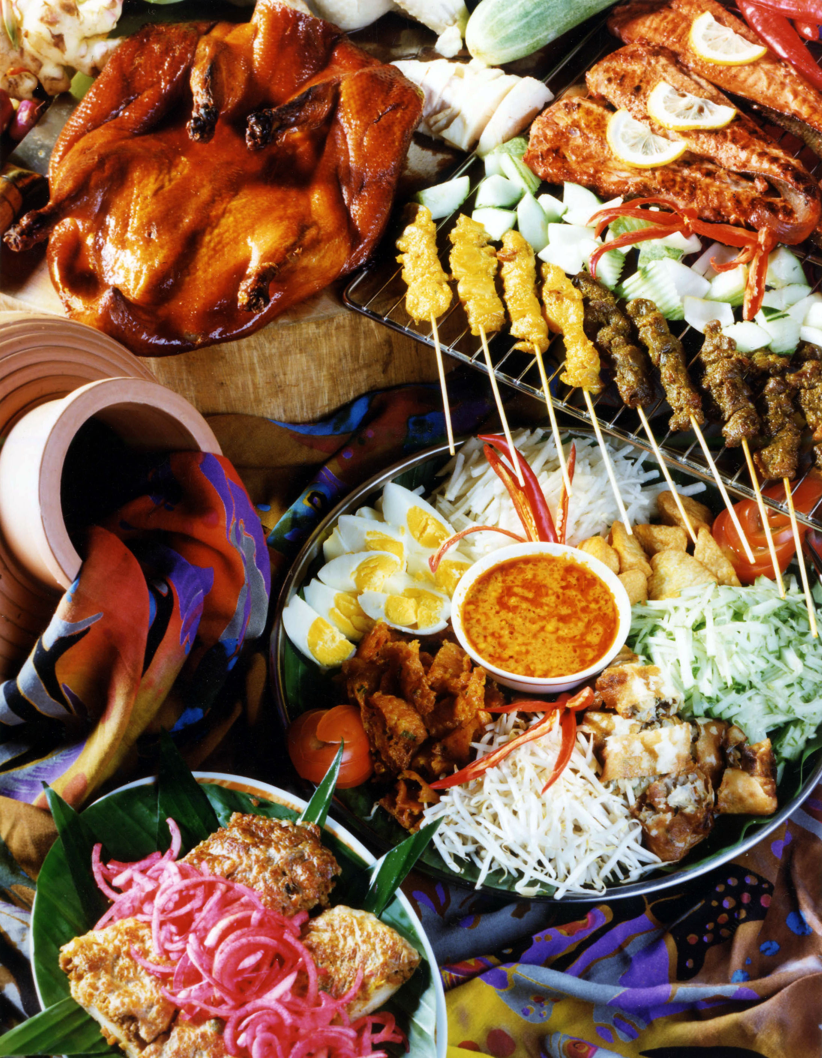

Male: 2,000
Female: 1,500
Daily Caloric Requirement of SEDENTARY Malaysian Male and Female

Slide 21
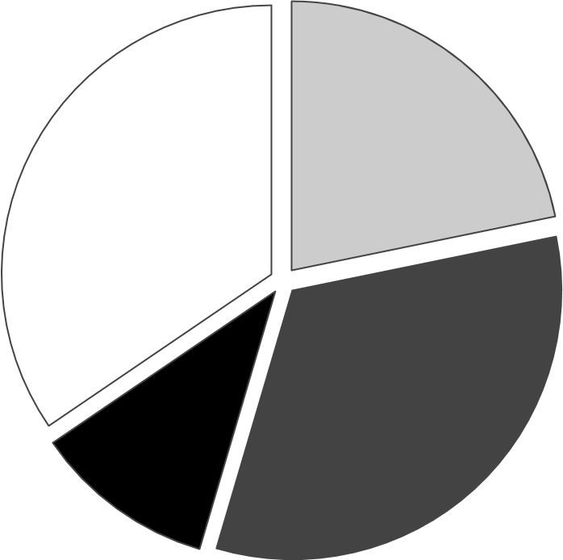
Caloric Requirement of SEDENTARY Malaysian Male and Female
60%
15-20%
Carbohydrates
Proteins
20-35%
As much as Possible
Fats
Vegetables

Slide 22
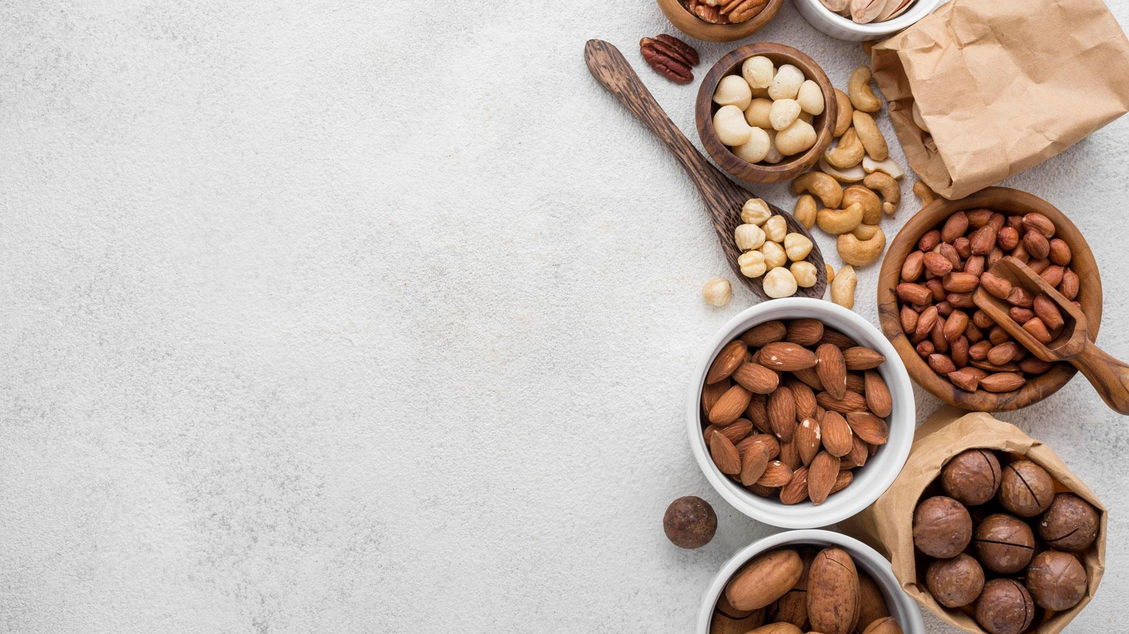
Serving Sizes
Carbohydrates = 6-8 Servings
Protein = 2 servings
Vegetables and Fruits = 5 or more
Fats =
½ cup rice = 1 serving
1 pc. Bread = 1 serving
1 cup noodle = 1 serving
85-170 gm of meat = 1 serving
1 cup lentil or beans = 1 serving
1 medium sized fruit = 1 serving
1 cup raw salad = 1 serving
½ cup cooked vegetables = 1 serving
44 grams to 77 grams of fat per day
Eg: 1 tbsp of butter and/or oil = 14 gm

Slide 24

Thanks!
Do you have any questions?
Email us: janeyap@maum.my
Follow us on FB: “EIGHT TREASURES”
Our website:
https://maumhealth.wixsite.com/eighttreasures/resources

