Slide 1
Trust in a Divine Being
The 8th of EIGHT TREASURES

Slide 2
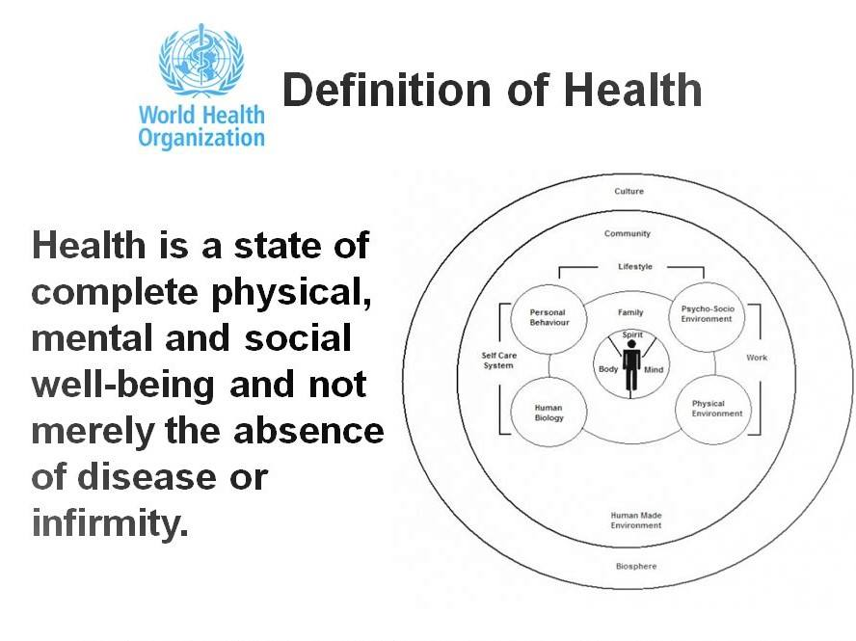
Definition of Health by the Whorld Health Orgnanization (WHO, 1947)

Slide 3

In the definition, there were only three dimensions of health mentioned: physical, mental and social.
Should a Fourth Dimension of health needed?

Slide 4
The World Health Organization has already realized the need for the 4th dimension of health, i.e., spiritual health, to be considered an important element of health. The special group of the WHO Executive Board (1998) proposed that the Preamble of the Constitution should be amended as follows:
“Health is a dynamic state of complete physical, mental, social, and SPIRITUAL well being and not merely the absence of disease or infirmity.”
Dhar N, Chaturvedi S, Nandan D. Spiritual health scale 2011: defining and measuring 4 dimension of health. Indian J Community Med. 2011 Oct;36(4):275-82. doi: 10.4103/0970-0218.91329. PMID: 22279257; PMCID: PMC3263147.

Slide 5
“90% of diseases originate in the mind. Sickness of the mind prevails everywhere. . . Remorse for sin sometimes undermines the constitution and unbalances the mind.”
Ellen White; Testimonies for the Church 5:444 (1885)

Slide 6

Impact of Belief or Trust in God in Health

Slide 7

All great civilizations have been founded on a belief in God and values leading to an orderly society.
A person’s strong spiritual belief can be a motivator to treat others well.
A strong spiritual values or belief can develop peaceful human relationship.
History demonstrates that faithless and lacking moral societies become so corrupt that they cannot survive.

Slide 8
Studies that confirming how spiritual health is related to physical and mental health.

Slide 9
Spirituality and Mental Health
A questionnaire survey was conducted among 595 students from six different universities
The results show that both spirituality and health-related behaviors are positively related to psychological well-being, and that the relationship with spirituality is also mediated by health-related behaviors.
This further shows that a person who has a relationship with God has a positive psychological well being.
Bożek A, Nowak PF, Blukacz M. The Relationship Between Spirituality, Health-Related Behavior, and Psychological Well-Being. Front Psychol. 2020 Aug 14;11:1997. doi: 10.3389/fpsyg.2020.01997. PMID: 32922340; PMCID: PMC7457021.

Slide 10
Spirituality and quality of life
A meta-analysis of 8,946 articles concerning research on patients with serious illness and have strong belief in God.
Result showed that for healthy people, spiritual community participation–as exemplified by religious service attendance – is associated with healthier lives, including greater longevity, less depression and suicide, and less substance use.
For many patients, spirituality is important and influences key outcomes in illness, such as quality of life and medical care decisions.
“Spirituality in Serious Illness and Health,” Tracy Balboni, Tyler VanderWeele, Stephanie Doan-Soares, Katelyn Long, Betty Ferrell, George Fitchett, Harold Koenig, Paul Bain, Christina Puchalski, Karen Steinhauser, Daniel Sulmasy, and Howard K. Koh, JAMA, online July 12, 2022, doi: 10.1001/jama.2022.11086.

Slide 11
Spirituality and recovery from illness and surgery
Spiritual commitment tends to enhance recovery from illness and surgery. For example, a study of heart transplant patients showed that those who participated in religious activities and said their beliefs were important complied better with follow-up treatment, had improved physical functioning at the 12-month follow-up visit, had higher levels of self-esteem, and had less anxiety and fewer health worries
Harris RC, Dew MA, Lee A, Amaya M, Buches L, Reetz D, Coleman C. The role of religion in heart-transplant recipients' long-term health and well-being. Journal of Religion and Health. 1995;34(1):17–32. [PubMed] [Google Scholar] [Ref list]

Slide 12
A fascinating study was made that examined the religious experience of Americans who reached the golden age or 100.
Among the centenarians the researchers foundthat religiosity had significantly enhanced health.

Slide 13

Individuals with strong religious faith reports:
Higher levels of life satisfaction.
Greater personal happiness.
Fewer negative psychosocial consequences of traumatic life events.

Slide 14
Can Prayer makes a difference?

Slide 15
A study conducted by Ohio University published in Journal of Psychology in 1991.
560 respondents; 95% classified as religious people: 54% Protestants, 25% Catholics
Using factor analysis, they were able to identify four types of prayer:
  Petitioner Prayer - Praying to God for material things you may need.
  Ritual Prayer - Praying to God by reading the book of prayers.
  Meditative Prayer - Praying to God by ‘feeling’ or being in His presence.
  Colloquial Prayer - Talking to God as to a friend; asking Him for guidance in making decisions.

Slide 16
Conclusion of the Study:
Colloquial prayer correlated most highly with happiness and religious satisfaction.
Ritual prayer associated with negative effect and feeling. Talking to God as to a friend, telling Him all our joys and sorrows, can bring happiness, healing and religious satisfaction.

Slide 17
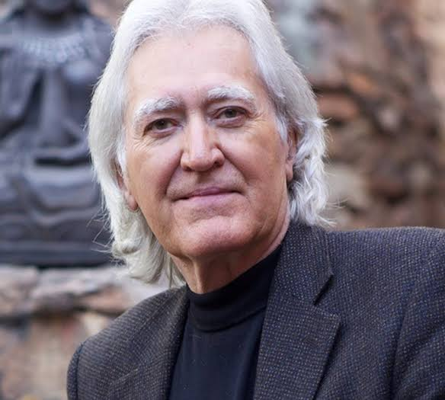
Dr. Larry Dossey a physician and author who propounds the importance for healing of prayer, spirituality, and other non-physical factors.
“I decided that not to employ prayer with my patients was the equivalent of withholding a potent drug or surgical procedure.”

Slide 18
Many people have tried to solve their problems through yoga or some similar internalized program of self-empowerment; these methods do not have the same effectiveness.

Slide 19

Yoga does not work!
Dr. Freda Morris, a former professor of medical psychology at UCLA, points out that eastern meditation is really a technique of self-hypnosis.
It is “potentially” dangerous.

Slide 20
“You will keep him in perfect peace, whose mind is stayed on You, because he trusts You.”
Isaiah 26:3

Slide 21

Only when we have a close relationship with God can we experience peace of mind.

Slide 22
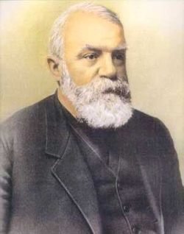
Dwight L. Moody:
Trust in yourself, and you are doomed to disappointment.
Trust in your friends, and they will die and leave you.
Trust in money, and you may have it taken from you.
Trust in reputation, and some slanderous tongue may blast it.
But – TRUST IN GOD, and you are never to be confounded in time or eternity.

