Slide 1

Sunlight
The 4th of the EIGHT TREASURES

Slide 2

Have you ever felt the sunshine of hope come to your soul after a long, dark night of despair? There’s something about the rays of warm sun that makes us feel refreshed and full of hope, no matter what problems we are facing. Not many people know, but the benefits of sunshine come not only from how it makes us feel emotionally but sunlight is an essential factor in overall good health.
Is sunlight a missing “nutrient” in your life?

Slide 3
Vitamin D is a very important component of our body. It helps regulate in the absorption of calcium – needed to keep bones, teeth and muscles healthy – as well as improve our immune system.
Ten percent of vitamin D is produced through the food that we eat while the remaining 90 percent is produced in the skin with the help of the sun.

Slide 4


Vitamin D is by far the greatest deficiency in the civilized world. In a survey, around 50% of the global population have vitamin D insufficiency (Nair and Maseeh, 2012).
In Asia, despite the presence of the tropical sun almost all-year round, yet people are still lacking vitamin D.

Slide 5

Research has shown some benefits of Vitamin D, through sunlight (1):
Vitamin D supports bone health, aids in lowering blood pressure, preventing disease, and promoting good mental health.
It plays a role in fighting against some diseases, including heart disease, auto immune diseases, and even reducing severe respiratory distress for patients with COVID infection

Slide 6
Research has shown some benefits of Vitamin D, through sunlight (2):
Vitamin D regulates mood disorders and reduce depression. Research has shown that vitamin D might play an important role in regulating mood and decreasing the risk of depression.
  For example, a review of 7,534 people found that those experiencing negative emotions who received vitamin D supplements noticed an improvement in symptoms. Vitamin D supplementation may help people with depression who also have a vitamin D deficiency.
It helps in the production of melatonin, a sleep hormone as well as serotonin, the mood elevator.

Slide 7
How Much Sun?
To maintain proper vitamin D levels, an adult with light skin needs about ten minutes of sunlight on bare skin daily without sunscreen between the hours of 10:00 a.m. and 4:00 p.m.
In seasons or places of low sunshine, vitamin D can be taken orally as a supplement.
The recommendation of 600–800 International Units (IU) of oral vitamin D daily is now considered by top researchers to be totally inadequate. The blood test will show if you need to increase your vitamin D by oral supplementation.

Slide 8
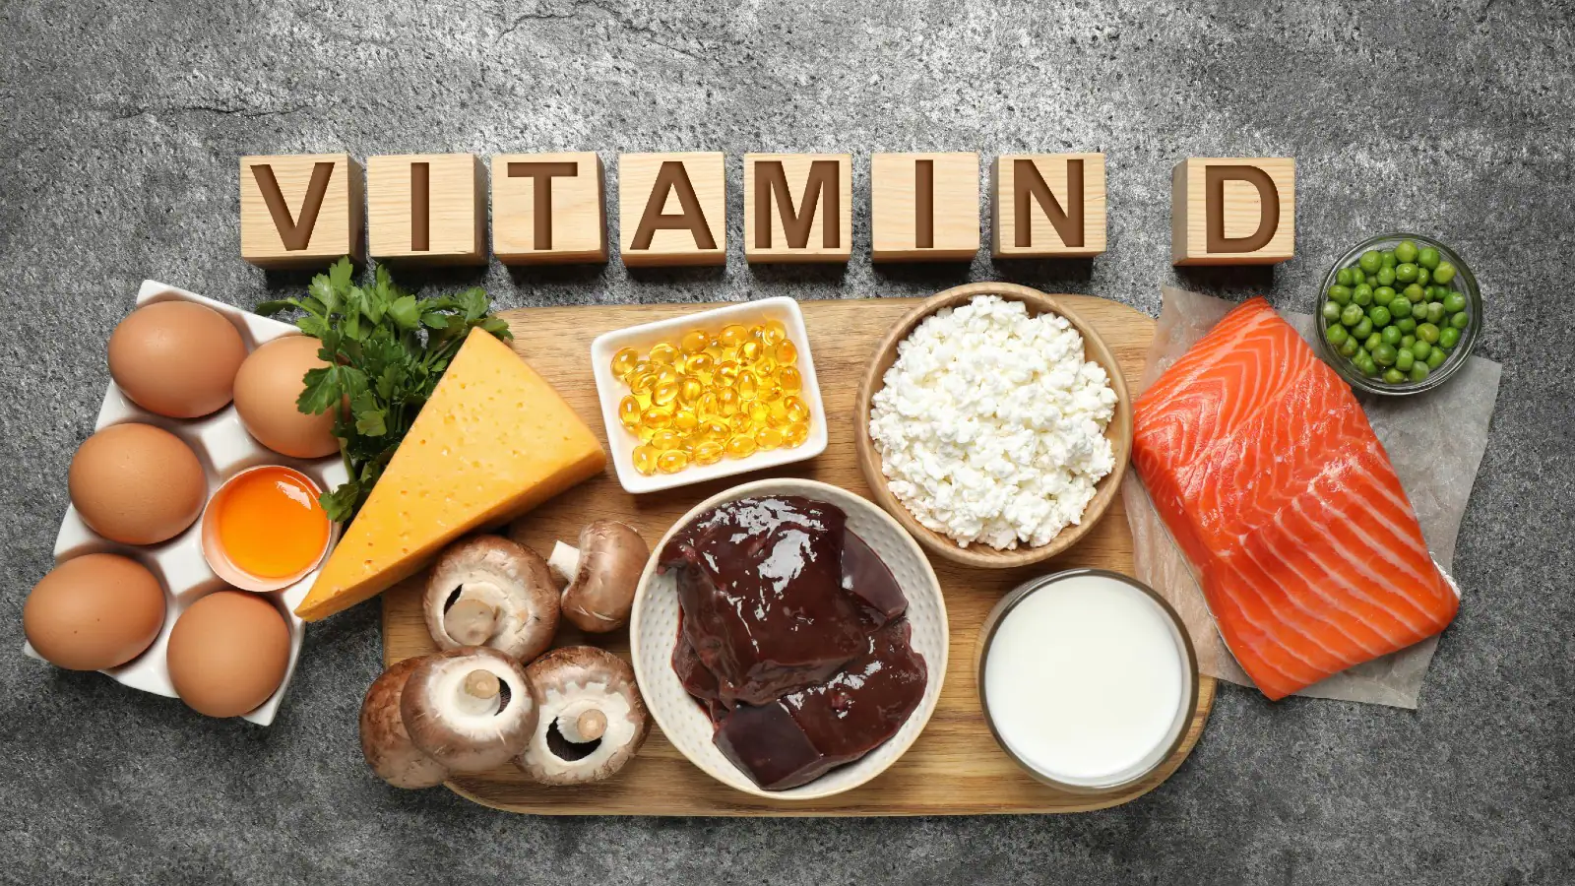
Vitamin D is also found in a small number of foods. Some of the sources of Vitamin D include:
Fortified milk or soymilk
Oily fish – such as salmon, sardines, herring and mackerel
Mushroom
Egg yolks
Fortified foods – such as some fat spreads and breakfast cereals

Slide 9

Many may ask, “How can I find out if I am vitamin D deficient?” In order to find out your blood level of vitamin D, it is essential to have the lab test Serum 25(OH) D.
For this you may consult your physician.

Slide 10


