Slide 1
“Temperance”
Avoid things that harm.

Slide 2
Content of this presentation
Explain the concept of “temperance”
Discuss the effects on the body in undertaking the habits of alcohol drinking and smoking.

Slide 3
Temperance is abstinence from the things that harm and moderation of things that are not harmful.

Slide 4

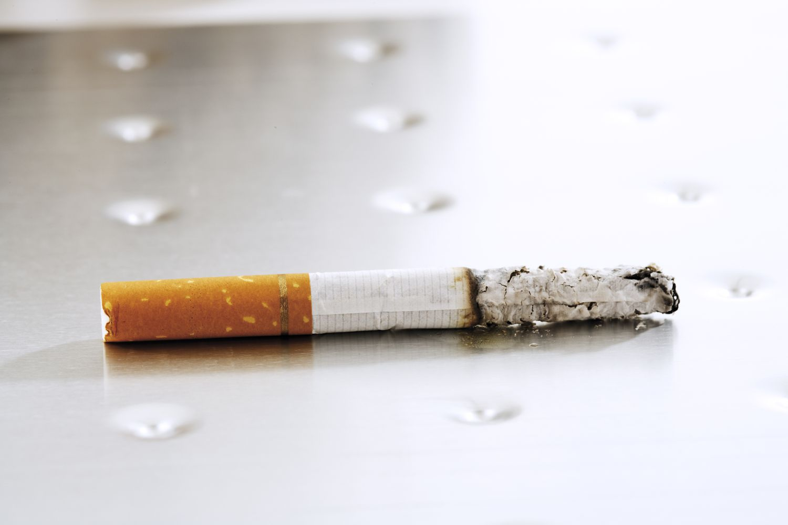
Habits that Harm
Alcohol Drinking
Cigarette Smoking

Slide 5
ALCOHOL
There are many reasons why people drink: for socialization, friendship, and having a good time, and to some, they drink for relaxation.
For these reasons, many disregard its harmful effect on the human body.
For example, within 15 minutes of consuming alcohol, it reaches the control center of our body, the brain, and from there affects our behavior, our speech, our judgment.

Slide 6


Alcohol controls our thinking which in turn controls us!

Slide 7

Alcohol and Heredity
Various researchers have shown that the sons of alcoholic fathers are influenced by alcohol at a significantly higher rate than the sons of non-alcoholic fathers as their resistance to alcohol is low.
It is possible that they go on drinking for longer because they perceive the negative effects of alcohol more slowly.
Schuckit MA. A Long-Term Study of Sons of Alcoholics. Alcohol Health Res World. 1995;19(3):172-175. PMID: 31798092; PMCID: PMC6875769.

Slide 8
Effects of Alcohol (1)
Alcohol drinking is known to be associated with death, addiction, intoxication, crime, abuse, and disease
Increases the acid in the stomach causing gastritis.
Damage to the intestine which may result in decreased absorption of nutrients.
Accumulation of uric acid which may lead to a gout attack
Disturb sleep pattern manifested by early waking and insomnia
Not eating food, thereby resulting in loss of protein, vitamins, and minerals leading to malnutrition.

Slide 9
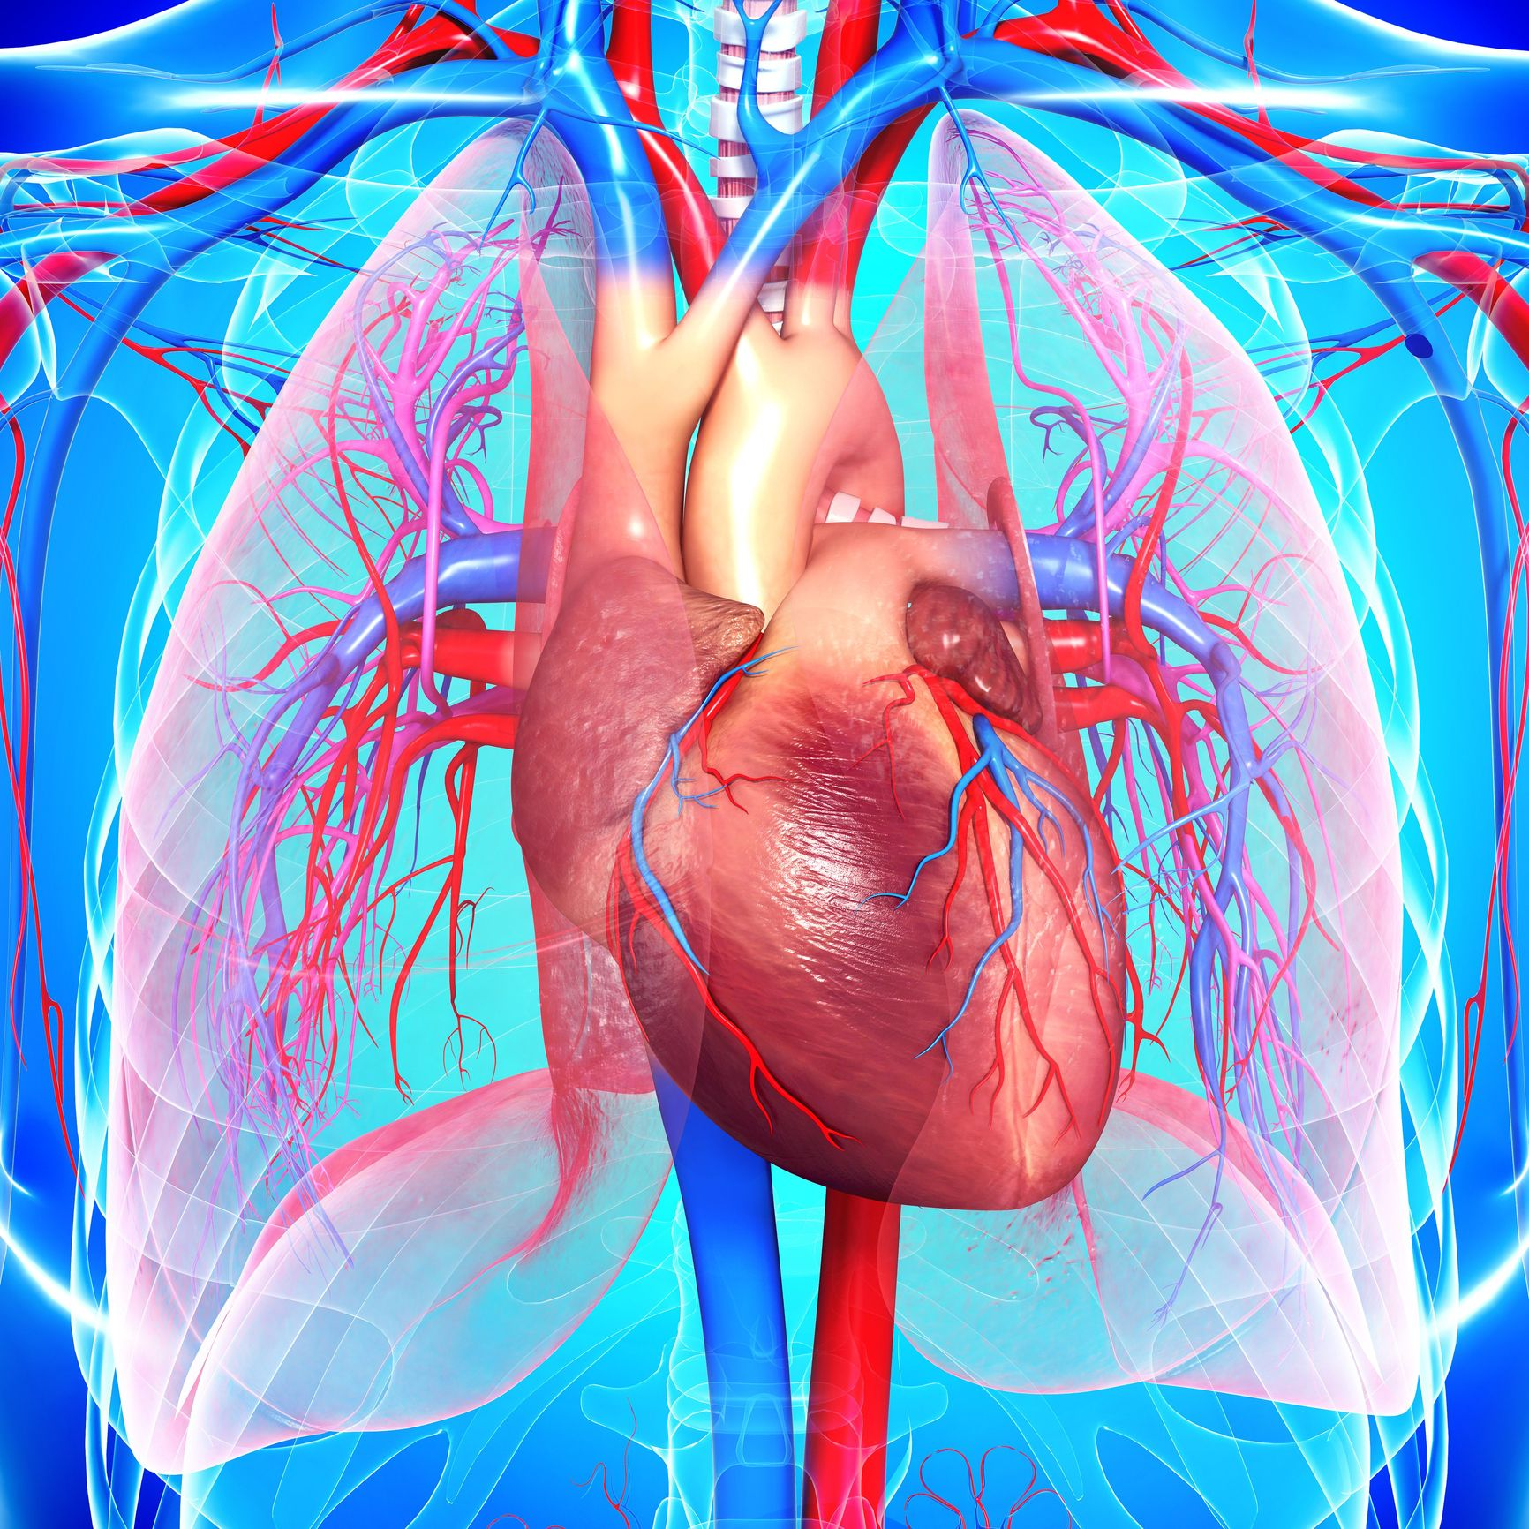
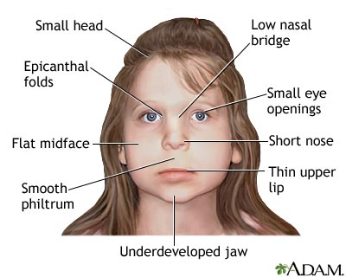
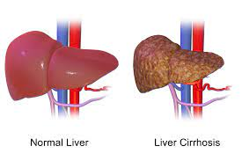
Effects of Alcohol (2)
Increases risk of cancer in the pancreas, mouth, tongue, throat
Liver disease, i.e. fatty liver, cirrhosis, hepatitis
Heart disease manifested through high blood pressure, stroke, heart failure, and heart muscle disease
Fetal alcohol syndrome, especially for pregnant woman who drinks alcohol.

Slide 10


Slide 11
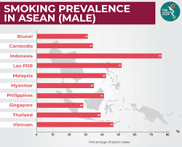
SMOKING
Advertisements in television, movies and newspaper project smoking to the youth as being cool, a habit that grown-ups do.
About 20% of Malaysians smoke, the fourth country in Southeast Asia with the most male smokers.
The ASEAN Post, 2019

Slide 12


Out of those who smoke, most start during their teens, a time when they are subjected to peer pressure and trying to find direction in life.

Slide 13
Dangerous Substances in Cigarette
Scientific studies have shown that smoking contains many dangerous chemicals.
There are around 4000 different chemicals in tobacco smoke that may be breathed in by someone who is near a smoker.
These harmful chemicals also stick to clothes, furniture, walls, and inside the car.

Slide 14
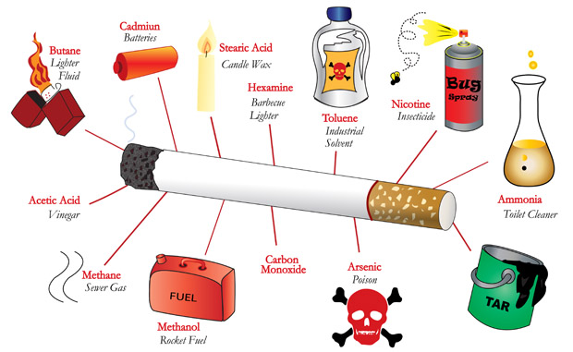
What’s in a Cigarette?

Slide 15
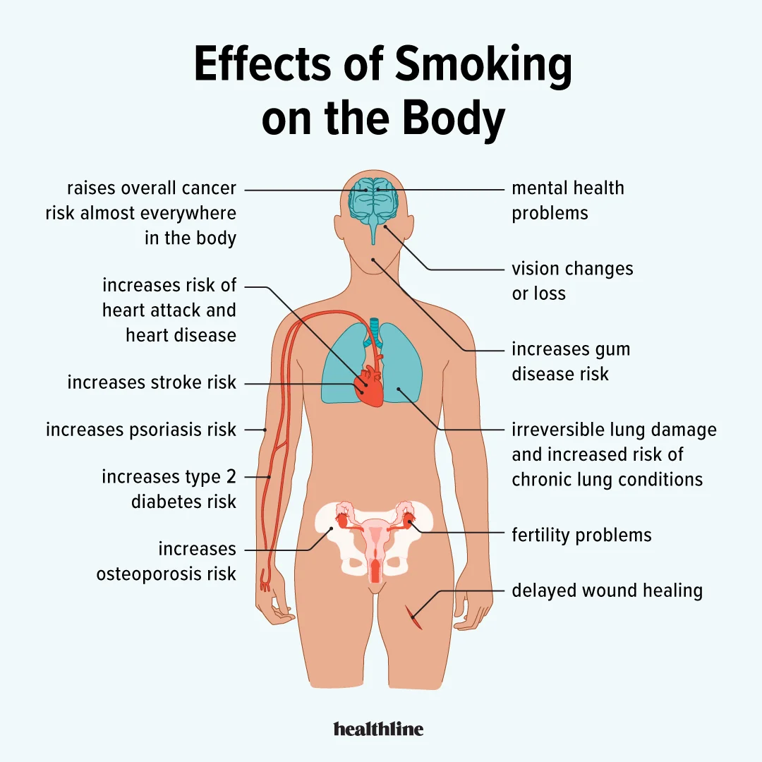
What are the effects of smoking in the body?

Slide 16
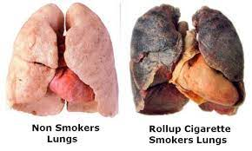
The death of a Smoker’s Lung

Slide 17
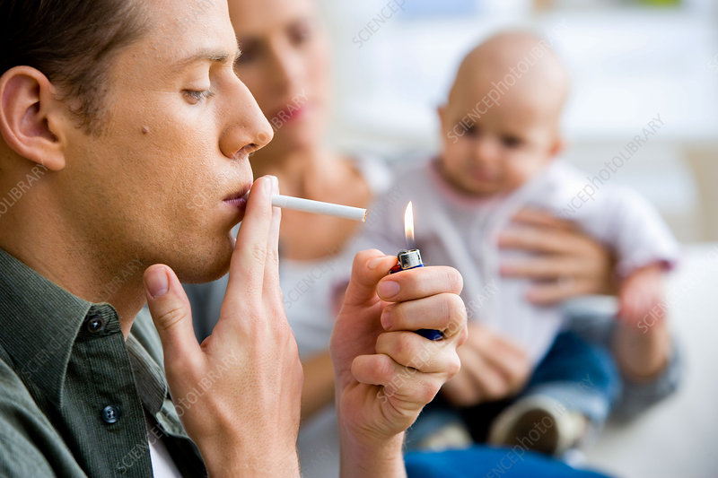
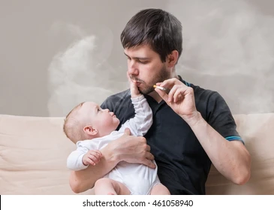
What is a “Passive Smoker?”
Passive smoking is when you breathe in the smoke from other people's cigarettes, cigars, or pipes.
It is a serious health threat — being exposed to tobacco smoke for just a moment can cause harm.
Unborn babies, children, and people with breathing problems are most at risk.
It is also known as “secondhand smoker”

Slide 18
Effects of Passive Smoking
For every eight smokers who die from a smoking-related disease, one non-smoker dies from second-hand smoke exposure.
Non-smokers who live with a smoker have a 25% to 30% greater risk of developing heart disease.
Second-hand smoke can cause or worsen a range of conditions and diseases including:
  cancer
  heart attacks
  heart disease
  respiratory infections such as pneumonia
  asthma
  diabetes

Slide 19
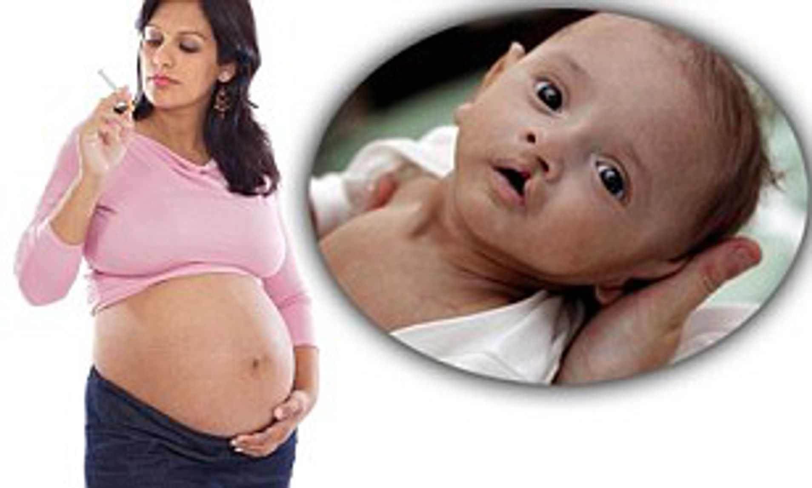
Unborn Babies and Smoking
Smoking tobacco or breathing in second-hand smoke when pregnant or breastfeeding can:
Affect the growth and health of your baby
Affect how your baby’s lungs develop
Increase the risk of stillbirth
Increase the risk of premature birth
Raises your baby's risk for birth defects, including cleft lip, cleft palate, or both.

Slide 20
What is a “THIRD-HAND SMOKE?”
Thirdhand smoke is made up of the pollutants that settle indoors when tobacco is smoked.
The chemicals in thirdhand smoke include nicotine as well as cancer-causing substances such as formaldehyde, naphthalene and others.
It builds up on surfaces over time and can become embedded in most soft surfaces such as clothing, furniture, drapes, bedding and carpets
Thirdhand smoke poses a potential health hazard to nonsmokers — especially children.

Slide 21
Thirdhand smoke poses a potential health hazard to nonsmokers — especially children.

Slide 22
Research has clearly shown that secondhand smoke causes many health problems, including cancer, heart disease and respiratory illness.
The effects from long-term exposure to the toxins in thirdhand smoke are not as well studied.
But research has shown that indoor smoking raises the risk of exposure to harmful chemicals, and that ventilation and cleaning cannot adequately eliminate these hazards.

Slide 23
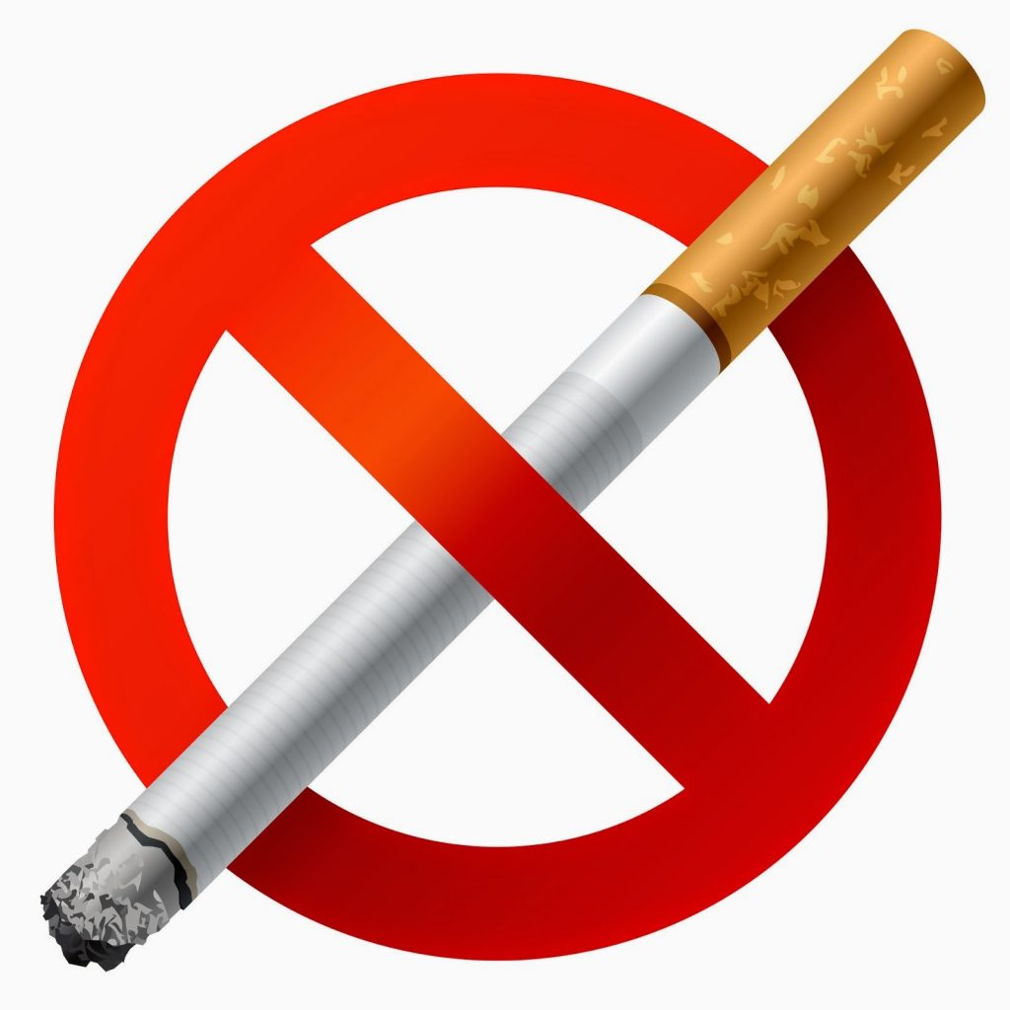
Before it Quits your life and your family’s.
…And to those who are thinking about smoking, Don’t. It is easy to start but hard to quit.

