Slide 1
In Search of Treasures

Slide 2
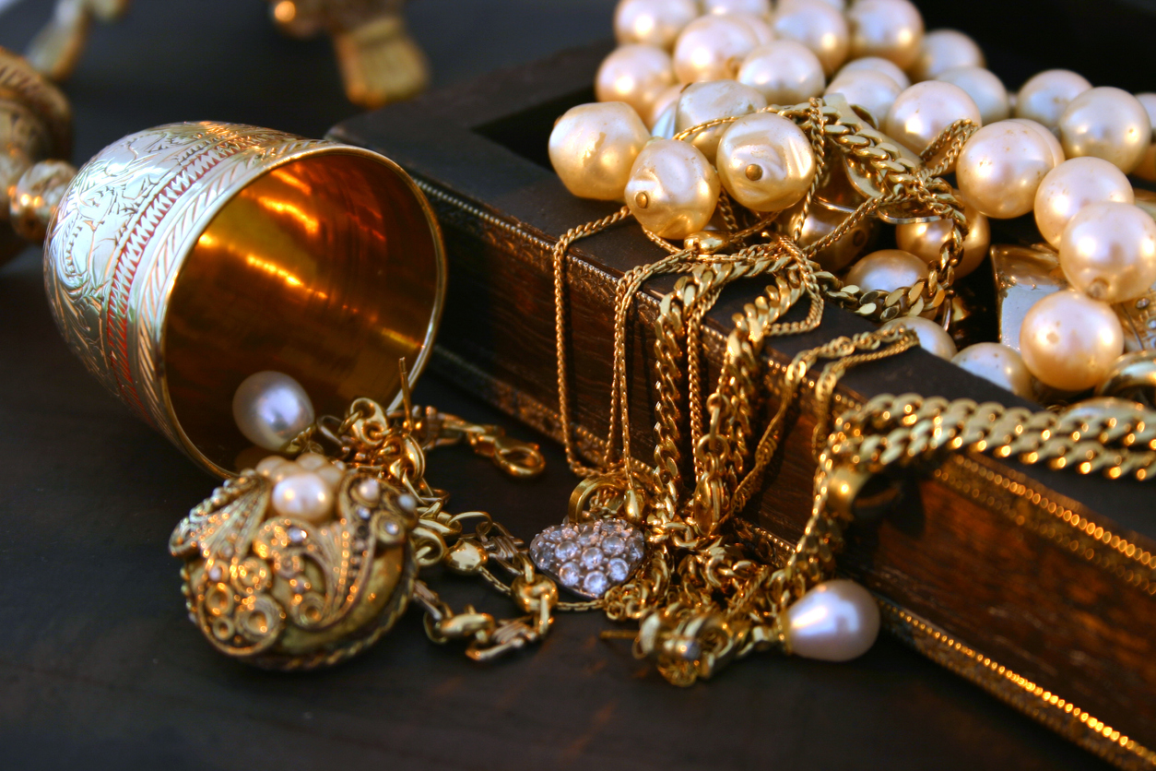

Some people have spent many times of their lives seeking for treasures. Some treasures come in gold, in different types of expensive stones, or in material possessions buried from ages of long time past.
The Treasure Seekers are hoping to be rich and to make their lives become better; or to some, they find the thrills of finding it.

Slide 3
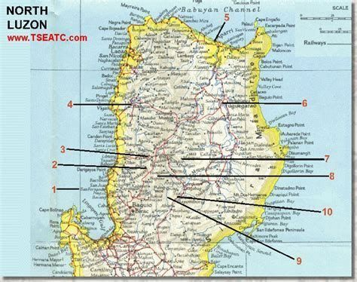
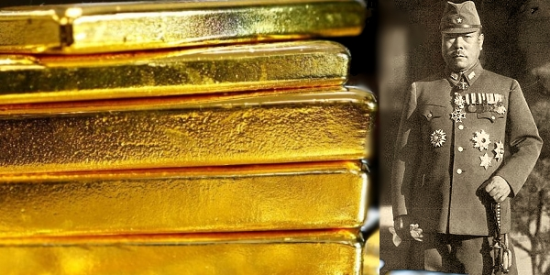
In the Philippines, for example, The never-ending search for General Yamashita’s fabled gold is a peculiar Filipino pastime.
…In almost every corner of the nation, amateur treasure hunters explore caves or excavate house posts in hopes of striking rich.

Slide 4
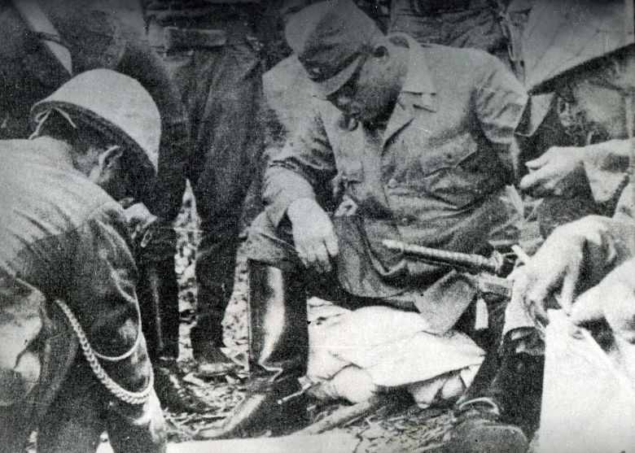
Legend has it that during World War II, the Japanese appropriated millions in war gold or silver from the territories they occupied.
Since the Japanese command under General Yamashita assumed that the Philippines would never be recaptured, it was chosen as the safest place to conceal the loot.
But at the close of the war, Allied and Filipino soldiers forced the Imperial Army to retreat in haste, leaving Yamashita’s gold behind in several undisclosed locations.

Slide 5
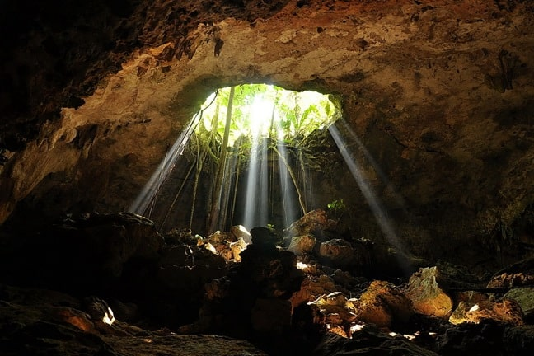
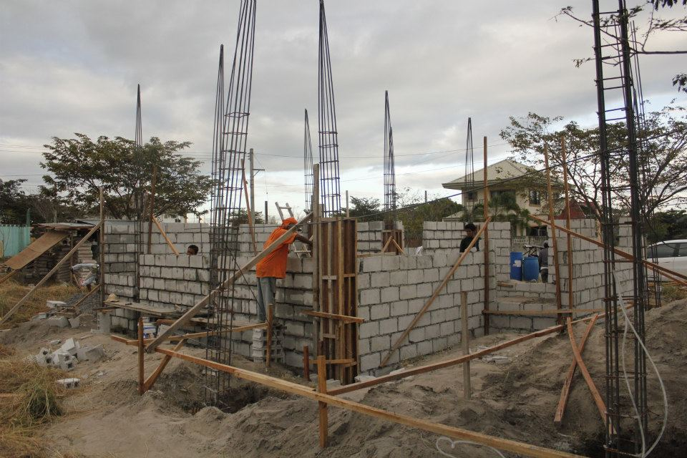
The cost of Treasure-hunting:
Irreparable damage to significant archeological digs.
Collapse of cave walls and the loss of artifacts.
Small communities being torn apart by nasty intrigues, as suspicions grow into jealous accusations against supposed discoverers of treasure.
Public building works have become sources of suspicion that it is a cover for the retrieval of Japanese treasure.

Slide 6
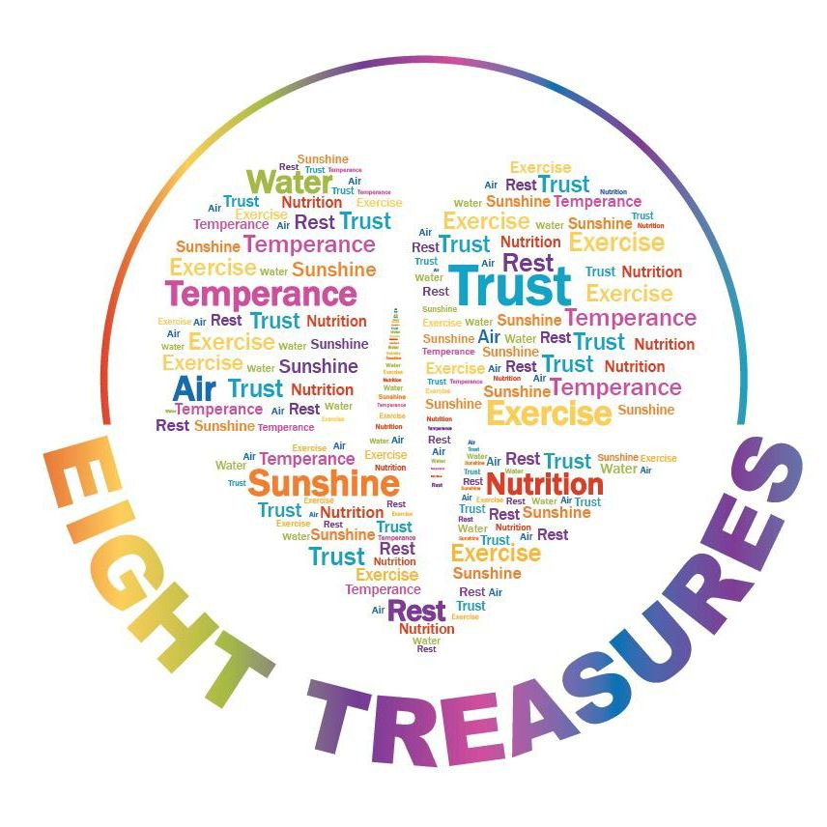
There is another treasure common to man but easily ignored.
This is the treasure of health.
It is God’s desire for us to be healthy and be free from the worries of disease.
For this reason, God gave us free choices on the Eight Treasures of heathy living.

Slide 7
The EIGHT TREASURES of Health

Slide 8
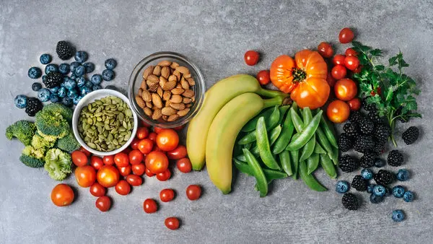
Nutrition: Healthy Glow, Healthy Life!

Slide 9
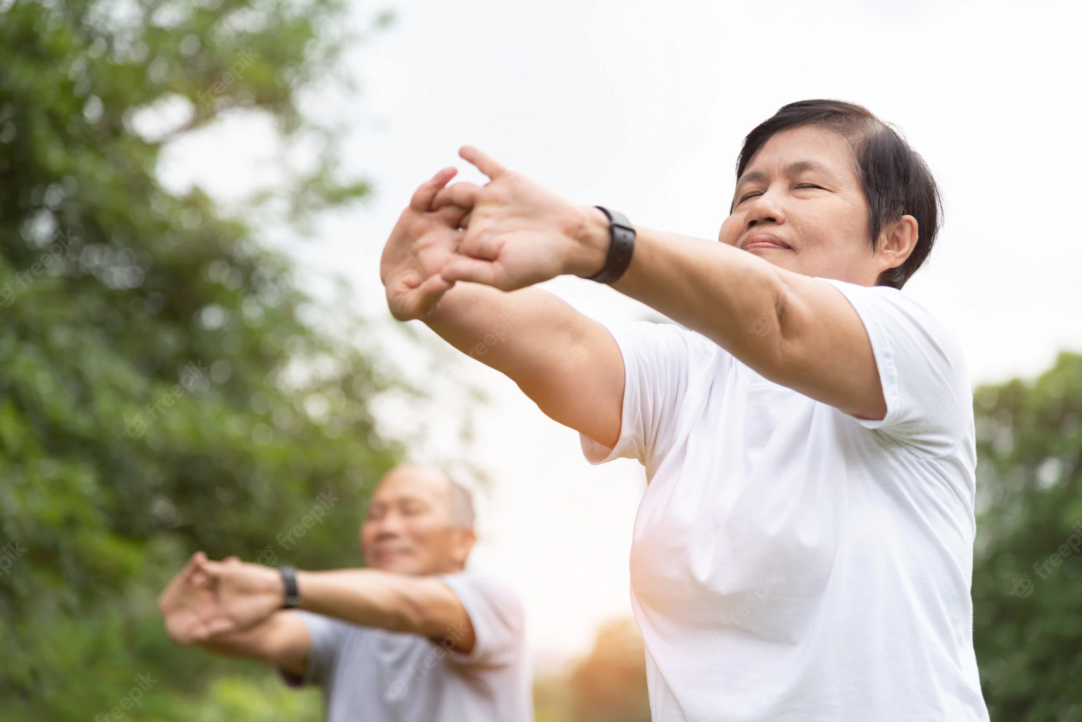
EXERCISE: we lose what we do not use.

Slide 10
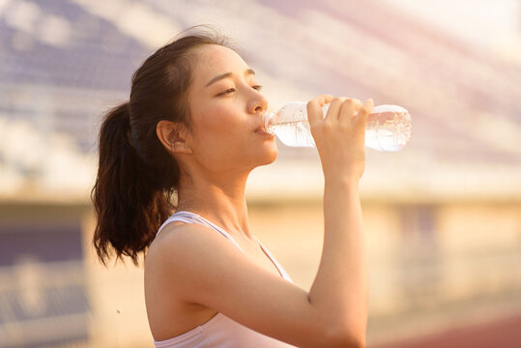
WATER: the elixir of our body.

Slide 11

SUNLIGHT: the root of happiness.

Slide 12

TEMPERANCE: saying no to harmful substances.

Slide 13
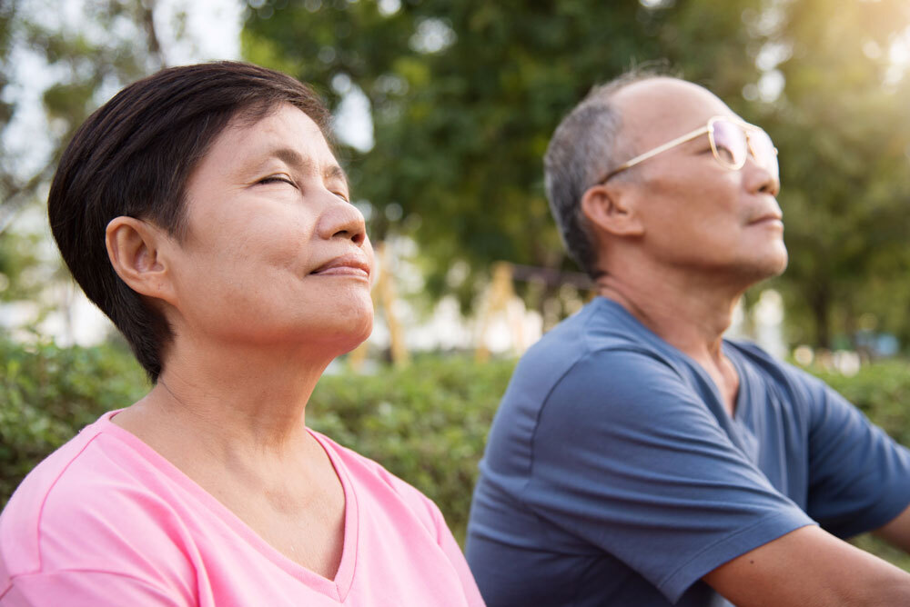
AIR: the oxygen of life.

Slide 14

REST: taking time to relax.

Slide 15
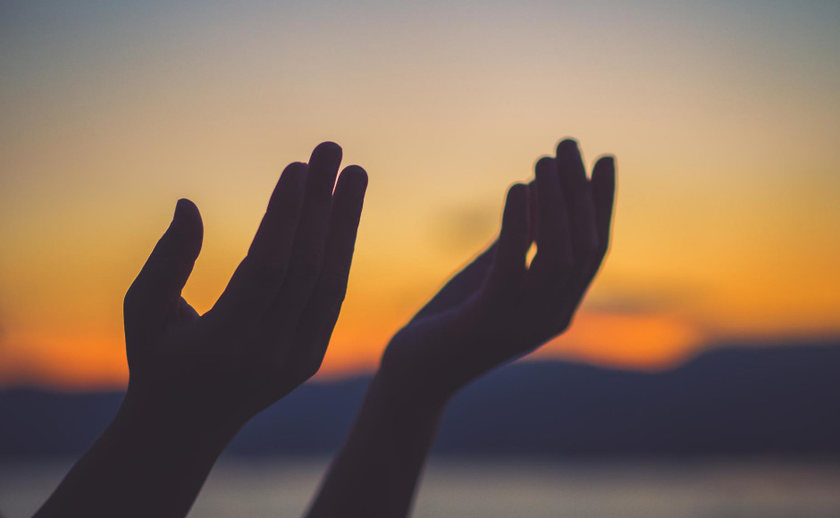
PRAYER: the foundation of good health.

Slide 16
Join us in search of these EIGHT TREASURES!

