Slide 1

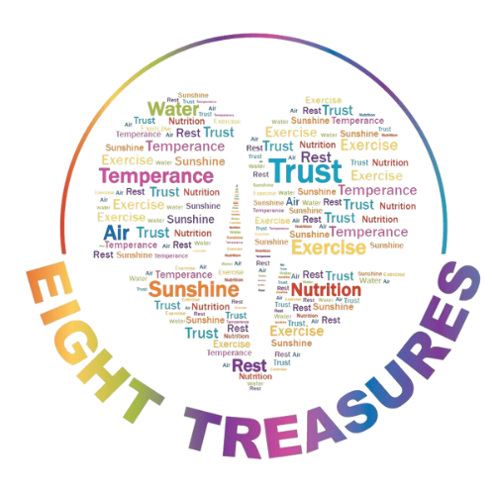
Fresh Air
The sixth of the Eight Treasures

Slide 2
You can live…
4 to 6 weeks, without food,
perhaps 5-7 days without water,
but only minutes without air and its life-giving oxygen!

Slide 3
“When you can’t breathe, nothing else matters.”
-Slogan of the American Lung Cancer Association

Slide 4
How long can you hold your breathe?

Slide 5

Fresh Air is a PERFECTLY balanced mixture
78% Nitrogen
21% Oxygen
1% Other Gases

Slide 6

What Makes a Fresh Air, ‘Fresh?”
High-quality fresh air is considered “electrified” meaning, it is negatively charged.
It is pure and clean.

Slide 7

Benefits of Pure, Fresh Air
It improves the sense of well-being.
Increases rate and quality of growth in plants and animals.
It aids in relaxation thus, decreasing anxiety.
Improves function of the lung’s protective cilia.
Lowers resting heart rate.
Decreases survival of bacteria and viruses in the air.
Improves learning.

Slide 8
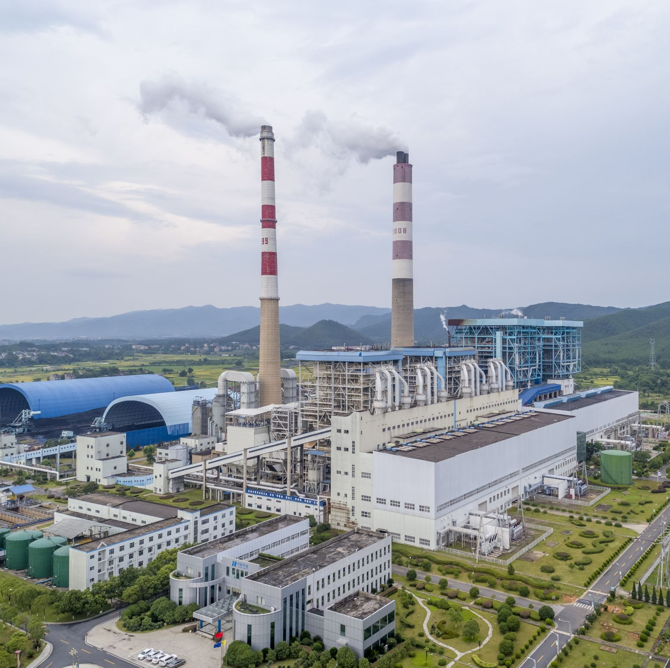
Destroyer of Fresh Air
Smoke from cars
Smoke from cigarettes
Smoke from factories
“Smog” or “Haze” due to burning of forests and over-industrialization in the big cities.
Indoor Air Pollution

Slide 9
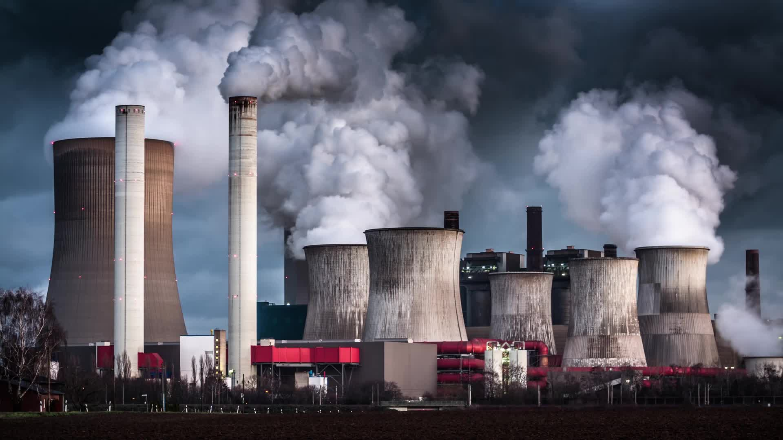
“Air pollution is one of the greatest environmental risk to health. By reducing air pollution levels, countries can reduce the burden of disease from stroke, heart disease, lung cancer, and both chronic and acute respiratory diseases, including asthma.”
- World Health Organization

Slide 10
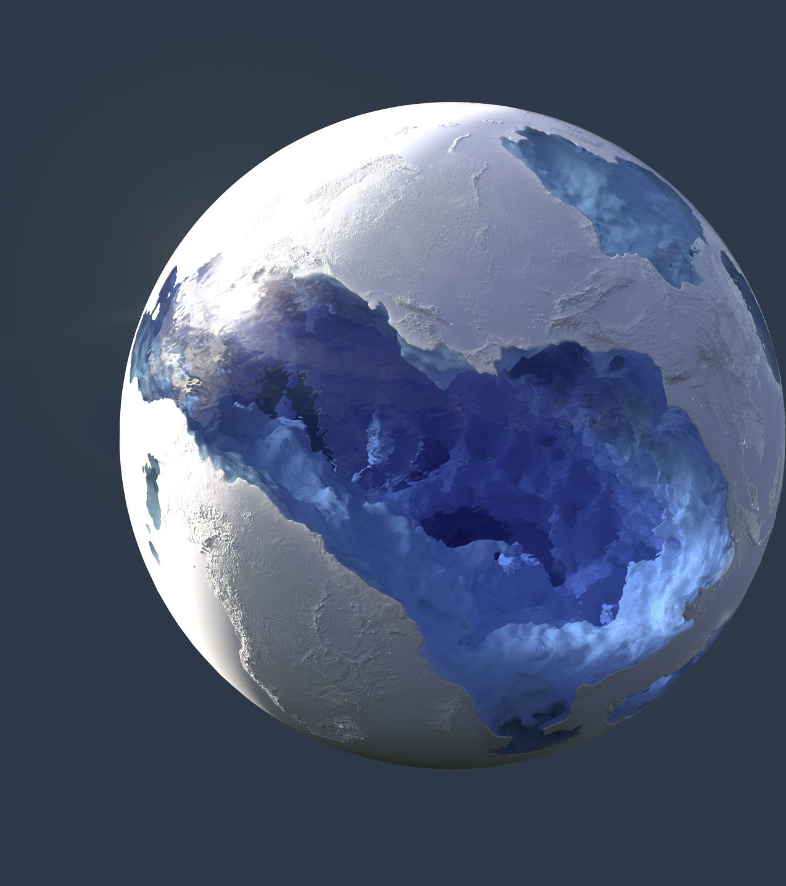
“Outdoor air pollution is estimated to have caused 4.2 million premature deaths worldwide in 2019; 89% of those premature deaths occurred in low- and middle-income countries, and the greatest number in South-East Asia region!”
-World Health Organization

Slide 11
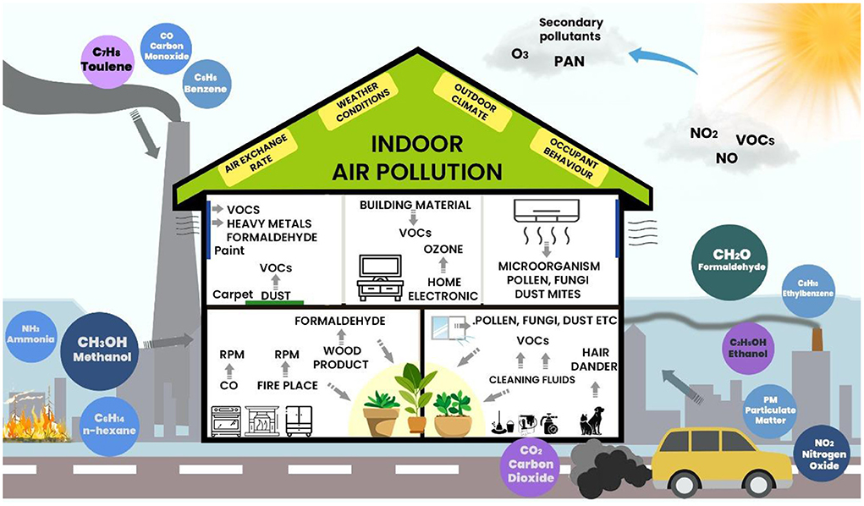

Slide 12
Indoor Air Pollution
Around 2.4 billion people worldwide cook using open fires or inefficient stoves fuelled by kerosene, biomass (wood, animal dung and crop waste) and coal, which generates harmful household air pollution.
Household air pollution was responsible for an estimated 3.2 million deaths per year in 2020, including over 237 000 deaths of children under the age of 5.
Household air pollution exposure leads to noncommunicable diseases including stroke, ischaemic heart disease, chronic obstructive pulmonary disease (COPD) and lung cancer.

Slide 13
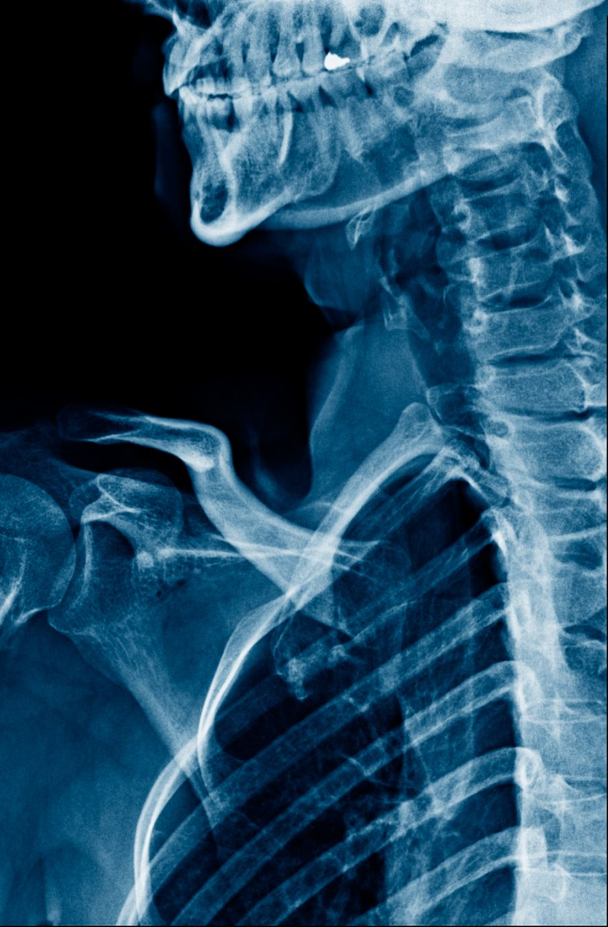
If you have these symptoms, perhaps you are exposed to a polluted, smoke-filled air:
Migraine headaches
Respiratory congestion (nose and throat)
Nausea
Vomiting
Diarrhoea
Eye problem
Irritability

Slide 14
Measures to get fresh, pure air
Have a green plant in your office or at home
Spend time going to a waterfall, ocean, sea, rivers, sea or forests.
Open the windows and take deep breaths after a thunderstorm.
Take deep breaths at least 5-10 times per day: slowly inhale through the nose, exhale through the mouth.
If you can, get an air purifier to be placed indoor.
Be conscious about your posture.

Slide 15
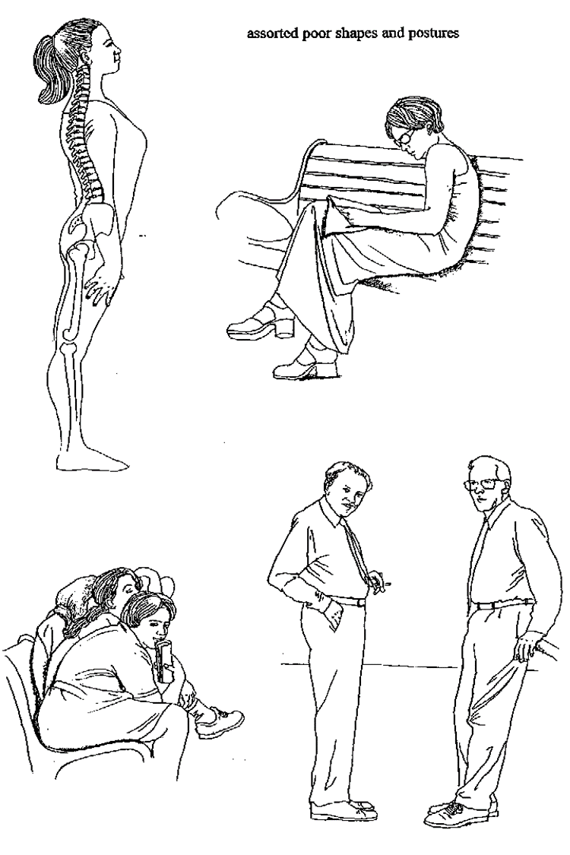
Poor Posture
Head down
Back bent
Shoulders round
Chest in
Abdomen out
Pelvis tilted sharply forward

Slide 16

Good Posture
Head up
Back straight
Shoulder straight
Chest out
Abdomen in
Pelvis flattened

Slide 17

Take regular intervals during work or study to breathe deeply preferably outdoors in the fresh air. This refreshers body and brain function.

Slide 18
Fresh, pure air is another one of those immeasurable God’s gift to humans. It is free and it is up to us to take.

