Slide 1
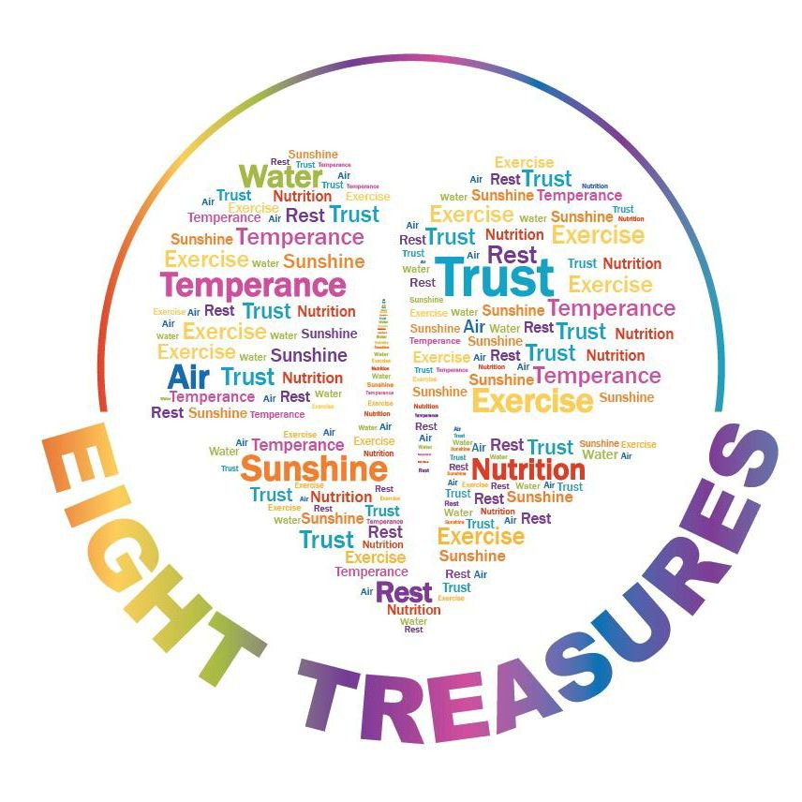
EXERCISE: Do I Really Need It?
The Second of the EIGHT TREAUSRES

Slide 2
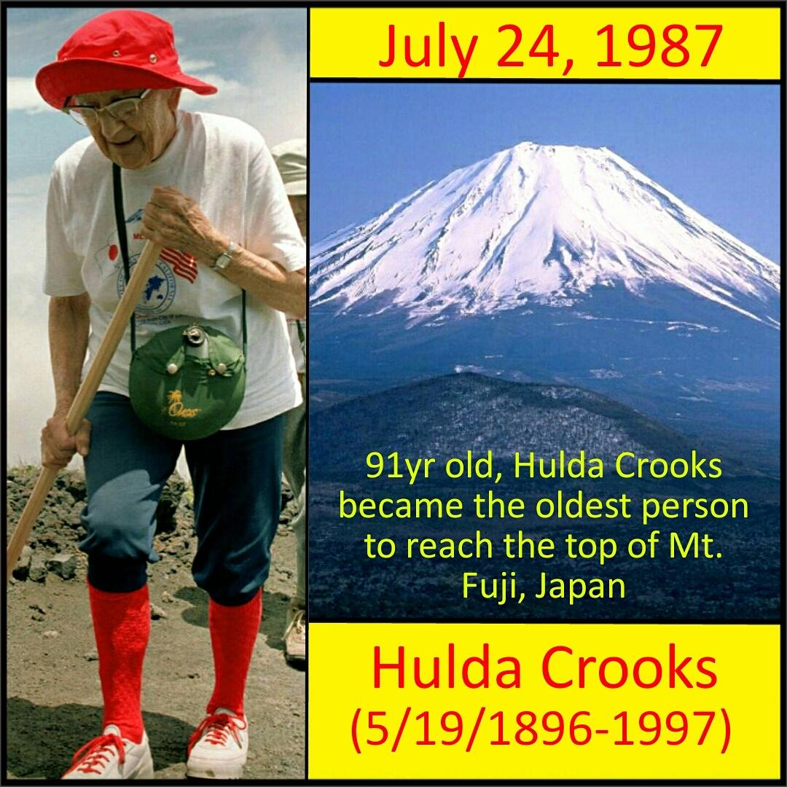
The Story of Hulda Crook
(May 19, 1896 – November 23, 1997)
was an American mountaineer, affectionately known as "Grandma Whitney“
She successfully scaled 14,505-foot (4,421 m) Mount Whitney 23 times between the ages of 65 and 91 and had climbed 97 other peaks during this period.
At the age of 91, she became the oldest woman to complete the ascent of Mt Fuji in Japan.
She died in 1997 at the age of 101.

Slide 3
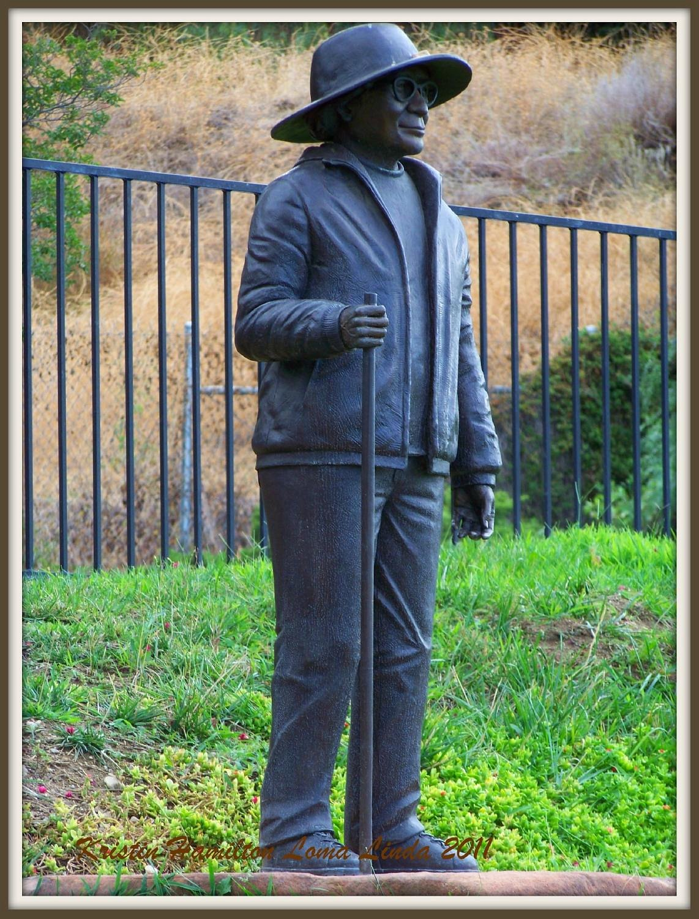
The other side of the story…
She did not engage too much in physical activity until the age of 60. She mentioned in the magazine, “The Adventist Review:”
“the more she moved the better she felt

Slide 4
There is no such thing as “too old” to engage in physical activity.

Slide 5
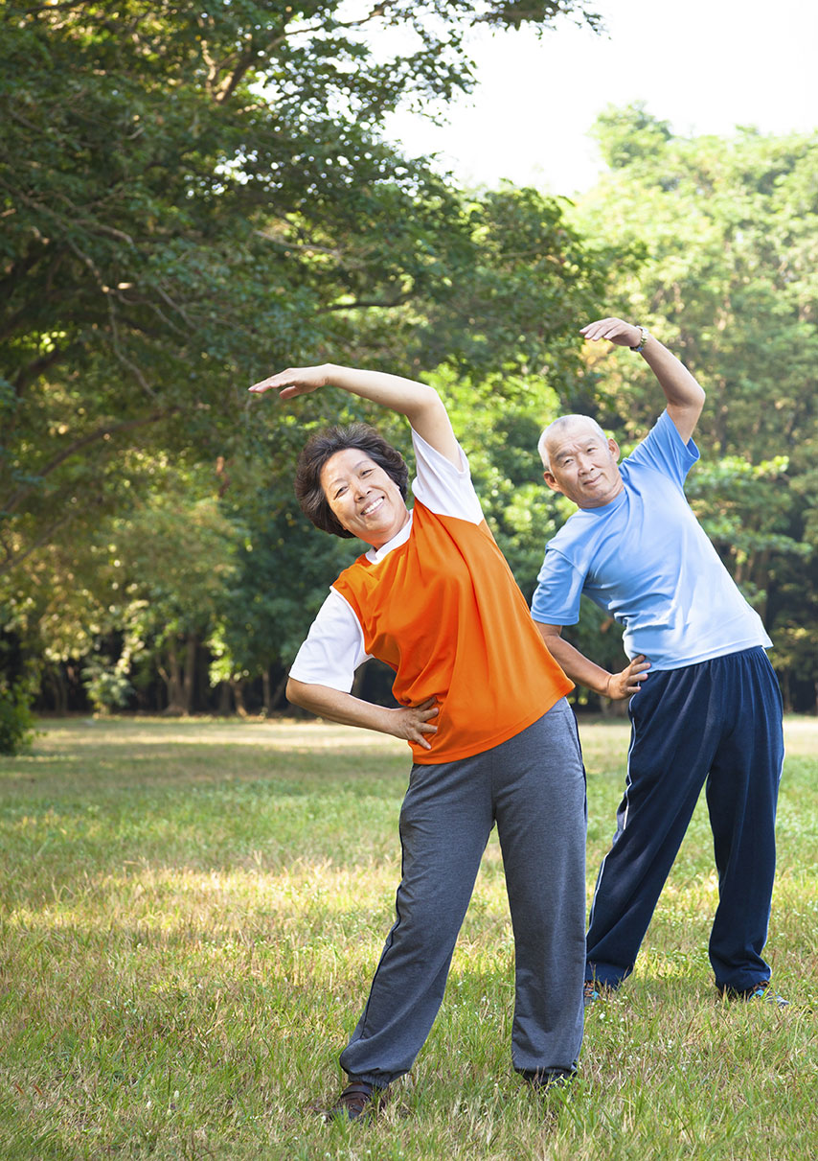
There are many benefits of Exercise, according to studies:
1. It enhances the immune system as the Natural Killer Cells’ activity to fight the disease are improved.
2. Moderate exercise helps control blood sugar
3. Exercise lowers the “bad cholesterol” and improves the good cholesterol.
4. It makes the bone strong thereby prevent it from being porous and easily breakage (a condition called “Osteoporosis).
5. It promotes weight loss.
6. It improves mood and prevent depression through the “happy hormones” produced during exercise.

Slide 6
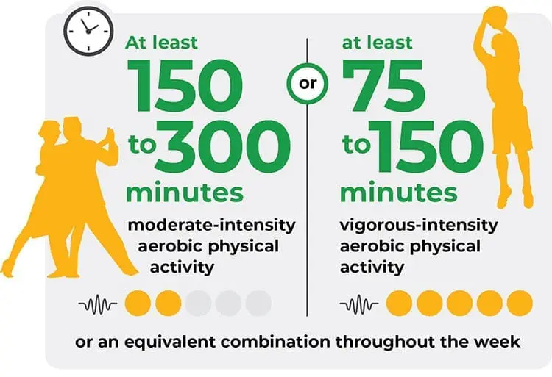
The World Health Organization recommendation:

Slide 7
How To Start?
PRACTICAL GUIDE

Slide 8
1. Consult with a Medical or Health Practioner
It is important to consult before starting a vigorous exercise program. See your doctor or other healthcare provider if any of these apply to you:
  You have a heart condition or you've had a stroke, and your doctor recommended only medically supervised physical activity.
  During or right after you exercise, you often have pains or pressure in the left or mid-chest area, left neck, shoulder or arm.
  You've developed chest pain or discomfort within the last month.
  You tend to lose consciousness or fall due to dizziness.
  You feel extremely breathless after mild exertion.
  Your doctor recommended you take medicine for your blood pressure, a heart condition or a stroke.

Slide 9
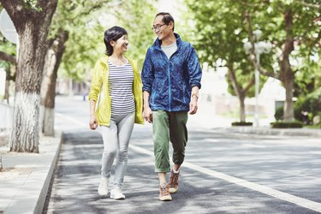
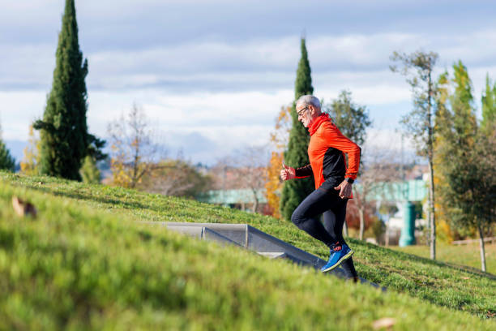
2. Begin Slowly
Use the stairs instead of elevator
Play games with the kids
Walk, don’t ride
Exercise to music
Exercise at a level you can converse with a partner
Join a fitness group or club
Progress slowly and gradually

Slide 10
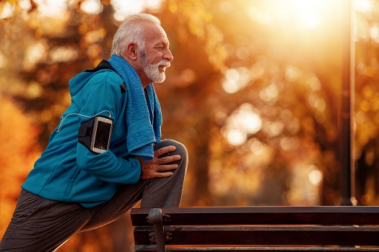
3. Follow the F-I-T Principle
Programs designed to improve physical fitness take into account FREQUENCY (how often), INTENSITY (how hard), and TIME (how long).
The FIT Formula:
F = frequency (days per week)
I = intensity (how hard, e.g., easy, moderate, vigorous)
T = time (amount for each session or day)

Slide 11
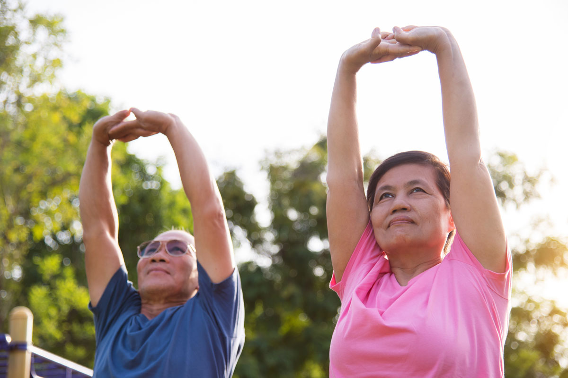
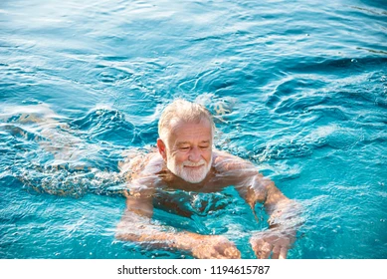
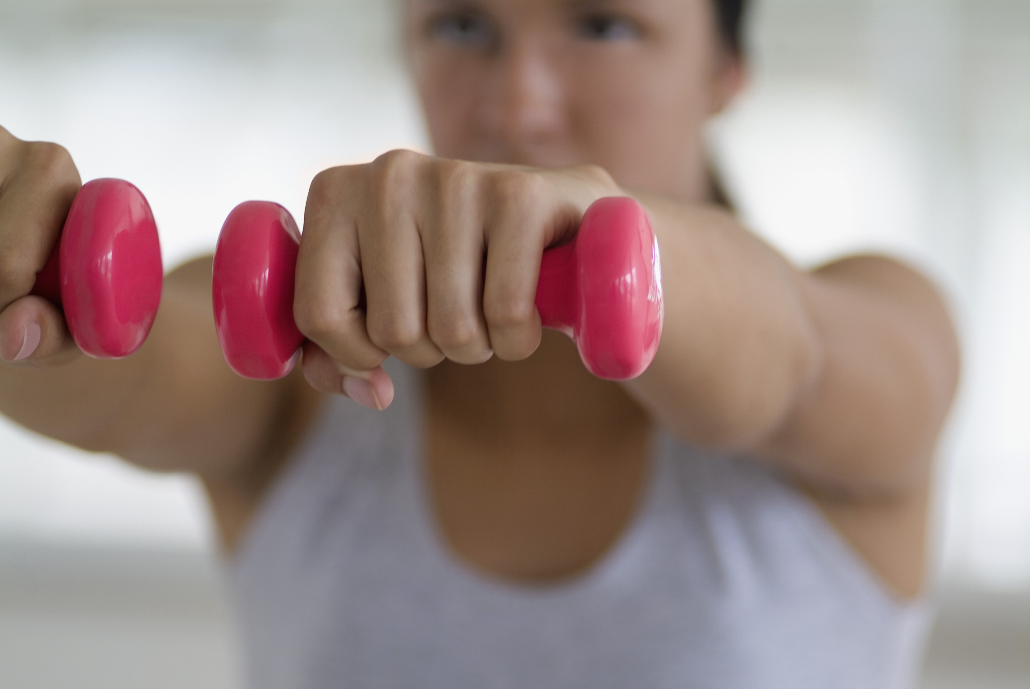
Three Types of Exercise
Aerobic Exercise
  Any activity with rhythm. Example: walking, swimming, dancing, walking on stairs, etc.
  This exercise is good for the heart and promotes well being.
  Constitutes the most of the exercise time, at least 30 minutes.
Flexibility
  Good for the joints and bones. This promotes balance, improves physical performance, decrease risk to injuries and increase blood flow to the muscle. May be done for 5-10 minutes.
Strength or Muscle Building
  This prevents muscular atrophy (muscle wasting). It promotes stronger bones and joint flexibility. May be done for 5-10 minutes.

Slide 12
Other considerations
Get proper shoes and attire. You must be comfortable.
Be consistent with your exercise regime.
Get people to join you. It is good to exercise with company.
Exercising outdoor has greater benefit.

Slide 13
How many steps do you take per day?

Slide 14
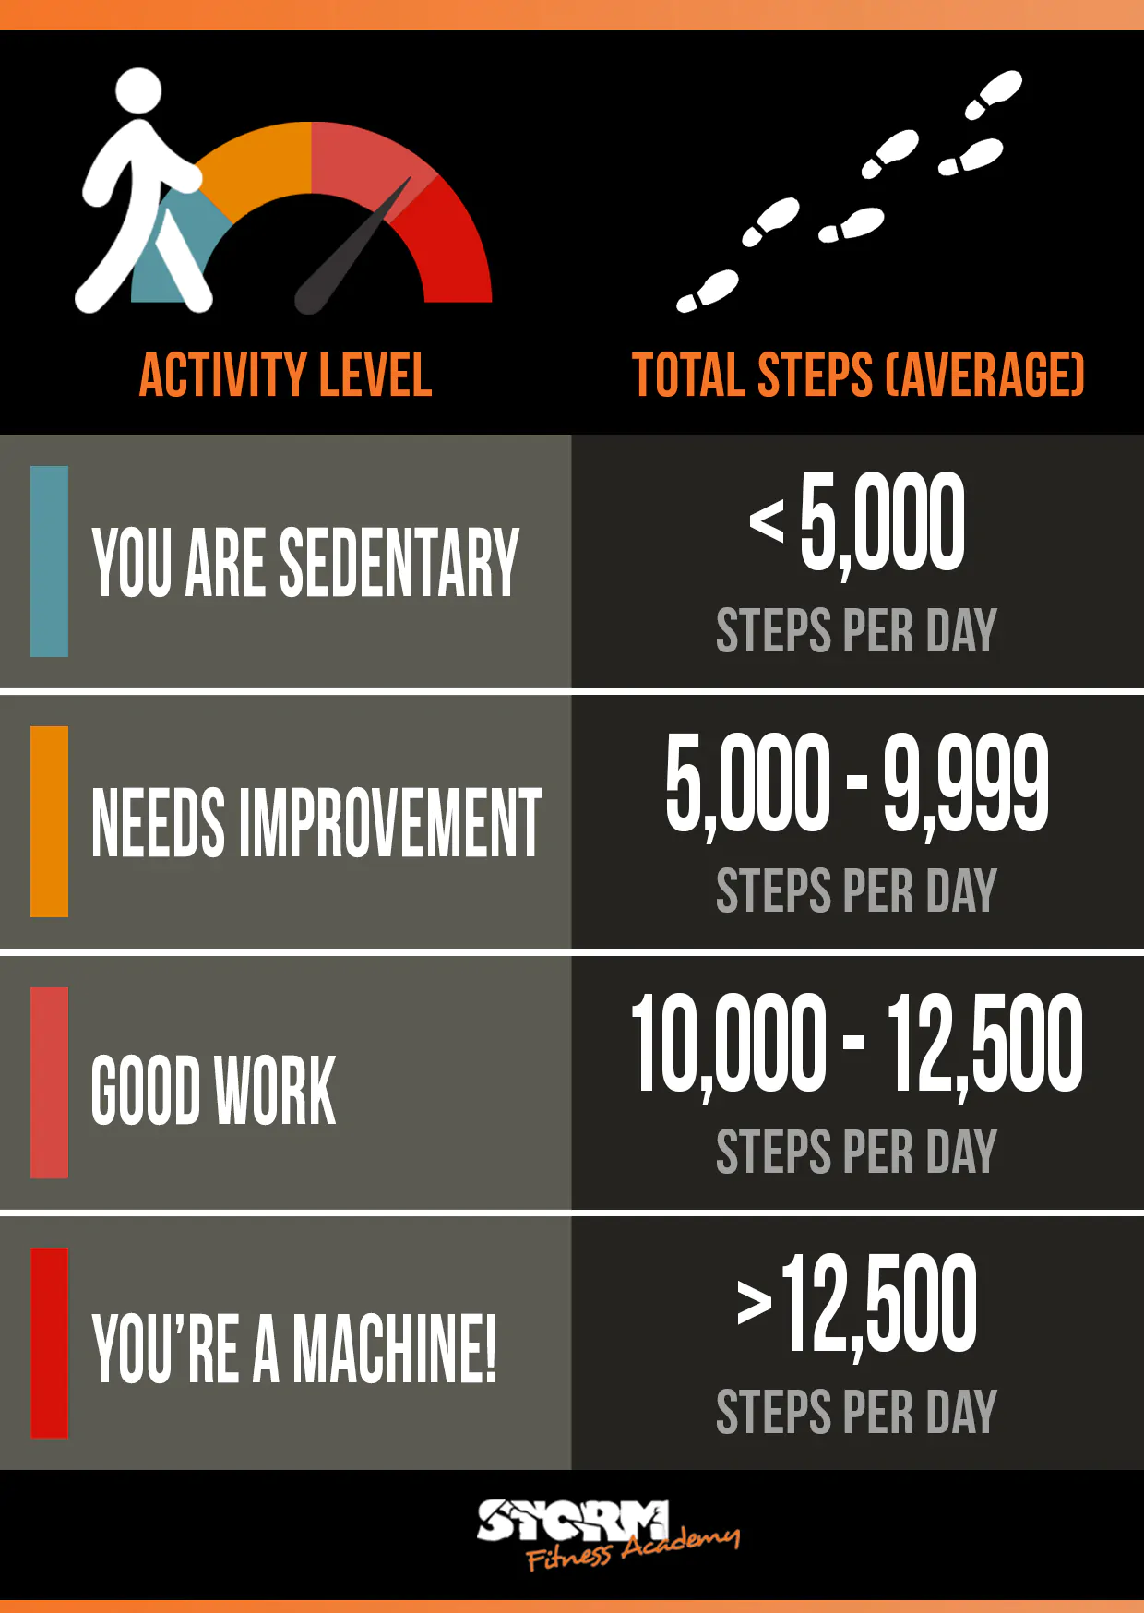
The World Health Organization Recommendation

Slide 15
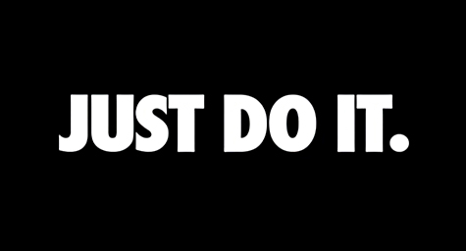
www.eight treasures .com
Eight Treasures FB Page

